Slide 1

Marijuana (Cannabis/THC) Information for Middle School Students
Notes:
Marijuana (Cannabis/THC): Information for Middle School Students was created by the Chippewa Valley Coalition for Youth and Families, a school-community coalition in mid-Macomb County, Michigan. It provides research-based information from national sources, including the Centers for Disease Control and Prevention (CDC) and others. This lesson takes approximately 1 – 1 ½ hours to present, depending on activities and discussion.
This lesson has been reviewed by Sara Orris, Health Consultant, Macomb ISD, and can be used to complement the Michigan Model for Health.
A Message to Teachers and Others Using this lesson:
Many children and adolescents today have significant misperceptions and much misinformation about marijuana.
National drug survey data, Monitoring the Future 2024, shows a positive trend across the grade levels, including middle school, in the perception that marijuana use can be harmful.
The intention of this power point lesson, with video, is to provide accurate, research-based information to educate youth about the real dangers of marijuana use. Please note that the term "marijuana" is used throughout the lesson because it is the term used in the Michigan Model for Health.
The terms "cannabis/THC" are also used for increased clarity.
This PowerPoint lesson is intended to be used as an instructional lesson for students in middle school health or other classes and/or for educational presentations to youth groups in other settings, e.g., churches, recreational centers, etc.
When some young people are provided with information about the dangers of marijuana use, they may respond with adamant disbelief, given their lack of fact-based information and the likelihood that some are marijuana users. Expressions of disbelief can lead to stimulating and helpful discussions.
We have also found it constructive to take the following positions, in presenting this information:
• I am not trying to convince you of anything. I am providing you with research-based information to consider.
• You might do some research yourself to see what you discover, however, there is much misinformation about marijuana on the internet. I can give you some reliable and research-based resources to review.
• Be careful to separate opinion from research-based facts.
Information to assist in using this lesson:
Many of the slides have accompanying information.
Some slides may have Teacher Comments, statements found useful during the piloting of the curriculum to enhance student learning. Some Teacher Comments are purposefully informal to be “student friendly”.
Some slides include Teacher Notes that provide supplemental information for teachers.
In addition, some slides provide suggested Group Activities to promote discussion.
This presentation was updated during August 2025.
National Health Education Standards were considered during the creation of this lesson and can be found at: https://www.shapeamerica.org/MemberPortal/standards/health/default.aspx

Slide 2
What is Marijuana?
Can be referred to as cannabis, THC, dabbing, shatter, sparking up, weed, pot, 420
The active ingredient is
THC, delta 9-tetrahydrocannabinol, the addictive chemical in marijuana.
A mixture of the dried and shredded leaves, stems, seeds, and flowers of the
cannabis plant.
Centers for Disease Control and Prevention (CDC)
NIDA
Notes:
A Reminder – some of the following slides have TEACHER COMMENTS, statements that may be used in class to enhance the lesson, and/or TEACHER NOTES, supplemental information for teachers.
Teacher Notes:
Cannabis can be used in a variety of ways.
The most common ways include:
Smoked in joints (like a cigarette), in blunts (cigars or cigar wrappers that have been partly or completely refilled with cannabis) or in bongs (pipes or water pipes)
Vaped using electronic vaporizing devices (like vape pens) or other vaporizers
Mixed or infused into foods or drinks (called edibles) like cookies, cakes, brownies, tea, cola, or alcohol
https://www.cdc.gov/cannabis/about/index.html

Slide 3

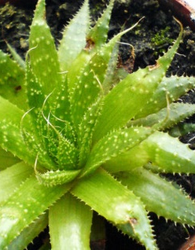
Not All Plants Are Safe!
Not all plants are safe to smoke or eat. (Tobacco is a plant.)
There are dozens of household plants that can poison people and pets (like Aloe Vera and Daffodils).
Heroin, cocaine, cyanide and strychnine are all dangerous substances made from plants.
CDC
Notes:
Some students might argue that marijuana is safe because it is a plant and is “natural”.
Teacher Comments:
Consider that poison ivy is a plant and even touching it has negative effects.
Some of you who have pets at home know that there are dozens of house plants that can harm your pet.
Centers for Disease Control and Prevention
http://www.cdc.gov/niosh/topics/plants/
https://www.cdc.gov/

Slide 4

Marijuana (Cannabis/THC) as Medicine
You may have heard that some people use cannabis and cannabis related products to help relieve depression, anxiety, and some physical health conditions.
SCHOLASTIC, NIDA, NIH, U.S. DEPARTMENT OF HHS
Notes:
Scholastic, NIDA, NIH, Department of HHS. Real News About Drugs and Your Body, 2023
https://nida.nih.gov/sites/default/files/NIDA_YR20_INS1_StudentMagazine.pdf

Slide 5
Marijuana (Cannabis/THC) as Medicine
All prescription medication used in our country needs to be approved by a government agency, the Food and Drug Administration (FDA).
The FDA makes sure that medications are safe and effective AND that the benefits are greater than the risks.
The FDA has NOT approved the cannabis plant itself for any health condition.
There are real health risks associated with using cannabis products.
SCHOLASTIC, NIDA, NIH, U.S. DEPARTMENT OF HHS
NIDA
Notes:
Teacher Notes:
The study of marijuana in clinical trial settings is needed to assess the safety and effectiveness of marijuana for the treatment of any disease or condition:
https://www.fda.gov/NewsEvents/PublicHealthFocus/ucm421168.htm#notapproved
The Federal Government currently considers marijuana to be a controlled substance with “no currently accepted medical use.”
Federal Law states that it’s illegal, under any circumstances, to grow, use, possess, or transport marijuana.
What's the latest on medical marijuana?
Research has shown that some chemicals in marijuana including THC and cannabidiol (CBD) could have medical uses.
Clinical trials are ongoing to develop and test medications that contain THC and/or CBD for pain relief or seizure disorders.
The Food and Drug Administration (FDA) will evaluate the results to determine if these medications are safe and effective for treating these conditions.
Scholastic, NIDA, NIH, Department of HHS. Real News About Drugs and Your Body, 2023
https://nida.nih.gov/sites/default/files/NIDA_YR20_INS1_StudentMagazine.pdf
http://www.scholastic.com/smp/pdfs/nida/NIDA-YR10-Stu_Comp.pdf

Slide 6
Marijuana (Cannabis/THC)
Some states, including Michigan, now allow marijuana (THC/Cannabis) to be used by people 21 and older.
It is NOT LEGAL
to use marijuana under the age of 21.
to use marijuana in public, including near or at a school.
to drive after using marijuana.
Michigan Legalization of Marihuana Law
Notes:
Teacher Comment:
Even if the laws are changing to allow adult marijuana use, scientific evidence shows that using cannabis poses real, and potentially serious, health risks for teens.
Michigan Legalization of Marihuana Law
https://www.legislature.mi.gov/(S(1bdtv43vras3vz5ifnhdd52n))/mileg.aspx?page=getObject&objectName=mcl-Initiated-Law-1-of-2018
Scholastic, NIDA, NIH, Department of HHS. Real News About Drugs and Your Body, 2023
https://nida.nih.gov/sites/default/files/NIDA_YR20_INS1_StudentMagazine.pdf
Teacher Note:
Michigan legalized adult use of marijuana in 2018.

Slide 7

Marijuana (Cannabis/THC)
You may have seen billboards advertising cannabis along main
roadways in the state.
This has led some to believe that cannabis use has no dangers.
Use of cannabis is unsafe, especially for youth.
It is important to learn the FACTS
and educate your friends.
SCHOLASTIC, NIDA, NIH, U.S. DEPARTMENT OF HHS
Notes:
Scholastic, NIDA, NIH, Department of HHS. Real News About Drugs and Your Body, 2023
https://nida.nih.gov/sites/default/files/NIDA_YR20_INS1_StudentMagazine.pdf

Slide 8
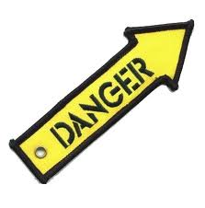
MARIJUANA (Cannabis/THC) HAS BECOME MUCH STRONGER OVER THE YEARS.
Cannabis Use Disorder (Addiction)
School Failure
Emergency Room Visits
Poison Control Calls
New Scientist & Scholastic, NIDA
Notes:
Teacher Comments:
Cannabis Use Disorder (Addiction) is a strong urge to keep taking marijuana, even when it is causing harm (problems in relationships, with academics, legal issues, emotional problems, etc.).
Further explanation of Cannabis Use Disorder (Addiction) is provided later in this PowerPoint.
In some cases, marijuana has been linked to severe symptoms that may require emergency care, such as vomiting, anxiety, shaking, and even seizures and psychosis. In some parts of the country, the number of marijuana-related hospital visits and calls to poison control have been increasing in recent years.
Scholastic, NIDA, NIH, Department of HHS. Real News About Drugs and Your Body, 2023
https://nida.nih.gov/sites/default/files/NIDA_YR20_INS1_StudentMagazine.pdf
Teacher Notes:
THC, the addictive element in marijuana, has increased significantly over time.
The data shows a clear trend: over the last 50 years, the average amount of tetrahydrocannabinol (THC)
in cannabis – the plant’s main psychoactive component – has increased more than tenfold.
Cannabis Use Disorder has come to replace the term addiction when talking about the inability to stop
using cannabis even after it causes problems for the user.
New Scientist. Is cannabis today really much more potent than 50 years ago? 11 October 2023
https://www.newscientist.com/article/2396976-is-cannabis-today-really-much-more-potent-than-50-years-ago/#:~:text=The%20data%20shows%20a%20clear,has%20increased%20more%20than%20tenfold.
https://www.cdc.gov/
https://nida.nih.gov/publications/drugfacts/cannabis-marijuana-concentrates

Slide 9

Video: Build a Brain (1 min.)
Notes:
Video: Click on the black box.
Teacher Comment:
Now we will watch a video that provides information about brain development and how marijuana use can interfere.
https://www.youtube.com/watch?v=HLYlDpJxxqs

Slide 10


How is Marijuana (Cannabis/THC) Used?
Smoked
Vaped
Eaten
In a Drink
CDC
Notes:
Centers for Disease Control and Prevention
https://www.cdc.gov/cannabis/about/index.html

Slide 11

Is Vaping Marijuana (Cannabis/THC) Safe? NO!
When marijuana (THC) is vaped, harmful chemicals can be inhaled.
The liquid in vaping devices can also contain dangerous drugs.
Scientists continue to study the risks of vaping marijuana and nicotine.
Scholastic, NIDA, NIH, Department of HHS
CDC
Notes:
Scholastic, NIDA, NIH, Department of HHS. Real News About Drugs and Your Body, 2023
https://nida.nih.gov/sites/default/files/NIDA_YR20_INS1_StudentMagazine.pdf
Centers for Disease Control and Prevention
https://www.cdc.gov/cannabis/health-effects/brain-health.html

Slide 12

Are Marijuana (Cannabis/THC) Edibles Safe? NO!
Marijuana is sometimes mixed into food (brownies, cookies, and candy, etc.), called edibles, or into drinks (soda and tea, etc.).
The potency (strength) of edible marijuana is often very high.
Many people who use edibles are caught off guard by the strength and long-lasting effects.
Some people that use edible marijuana need to be treated in hospital emergency rooms.
Scholastic, NIDA, NIH, Department of HHS
CDC
Notes:
Scholastic, NIDA, NIH, Department of HHS. Real News About Drugs and Your Body, 2023
https://nida.nih.gov/sites/default/files/NIDA_YR20_INS1_StudentMagazine.pdf
Centers for Disease Control and Prevention
https://www.cdc.gov/cannabis/health-effects/poisoning.html
Teacher Notes:
There is a Rise in Marijuana’s THC Levels:
The amount of THC in marijuana has been increasing steadily over the past few decades.
When people begin to use marijuana, they have a greater chance of harmful reactions to high THC levels.
The availability of edibles increases the chance of harmful reactions. Edibles take longer to digest and produce a high.
Therefore, people may consume more to feel the effects faster, leading to dangerous results.
Higher THC levels can result in a greater risk for Cannabis Use Disorder.
https://www.cdc.gov/cannabis/health-effects/cannabis-use-disorder.html

Slide 13
What Can Happen When Someone Uses Marijuana (Cannabis/THC) ?
Potential Short-Term Problems
Marijuana use can interfere with:
Emotions (create anxiety, paranoia, panic)
Coordination
Memory
Thinking (create psychosis/distortion of reality)
Decision making
Concentration & Learning
Heart Rate
Scholastic, NIDA, NIH, Department of HHS
Notes:
Teacher Comments:
Every time a drug is used, including marijuana, there are risks.
No one can control the effects marijuana will have.
Effects for the same person using marijuana may be different over time.
Some negative effects such as concentration/learning problems, and paranoia (unreasonable fear)/panic can last for days after marijuana is used.
Scholastic, NIDA, NIH, Department of HHS. Real News About Drugs and Your Body, 2023
https://nida.nih.gov/sites/default/files/NIDA_YR20_INS1_StudentMagazine.pdf

Slide 14
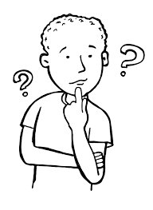
What Can Happen When Someone Uses Marijuana (Cannabis/THC)?
Potential Long-Term Problems
Risk of Cannabis Use Disorder (Addiction)
School failure & drop out
Permanent brain changes
Depression & suicidal thoughts
Heart disease & stroke
Eating & sleeping problems
Breathing problems
Frequent & severe vomiting
Scholastic, NIDA, NIH,
Department of HHS
CDC, UPI, APA
Notes:
Marijuana use in teenage years may hinder brain development, study finds - UPI.com
Scholastic, NIDA, NIH, Department of HHS. Real News About Drugs and Your Body, 2023
https://nida.nih.gov/sites/default/files/NIDA_YR20_INS1_StudentMagazine.pdf
Centers for Disease Control and Prevention
https://www.cdc.gov/cannabis/health-effects/brain-health.html

Slide 15
A Cannabis Use Disorder (Addiction) is…
a strong urge to keep using marijuana even when it is causing harm (problems in relationships, with academics, legal issues, emotional problems, etc.)
CDC
Notes:
Click on this slide to bring up definition.
Teacher Comments:
Cannabis Use Disorder is the diagnosis given by doctors to people who are addicted to marijuana.
American Psychiatric Association. (2022). Diagnostic and statistical manual of mental disorders (5th ed., text rev.)
https://www.cdc.gov/cannabis/health-effects/cannabis-use-disorder.html

Slide 16



Stopping Marijuana (Cannabis/THC) Use Can Be Very Difficult
When people try to stop using marijuana they often:
Are irritable & angry
Are stressed & nervous
Have problems eating & sleeping
Have urges to keep using the drug
American Psychiatric Association
Notes:
American Psychiatric Association (2022). Diagnostic and statistical manual of mental disorders (5th ed., text rev.)
https://doi.org/10.1176/appi.books.9780890425787

Slide 17

Marijuana (Cannabis/THC) is Addictive
The EARLIER marijuana use begins,
the GREATER the risk of addiction.
1 in 6 teens that use marijuana become addicted
SAMHSA
Notes:
Learn About Marijuana Risks, SAMHSA 2023
https://www.samhsa.gov/marijuana
Teacher Notes:
It is estimated that 10% (about 1 in 10) of adults who use marijuana will become dependent on it and develop a Cannabis Use Disorder.
The number goes up to about 1 in 6 in those who start using in their teens.

Slide 18

Stopping Marijuana (Cannabis/THC) Use Can Be Very Difficult.
Don’t start,
or get help
to quit!

Slide 19

Video (2:03 min.) Why Are Drugs So Hard to Quit?
Notes:
Video: Click on the black box.
Teacher Comments:
This brief video provides information about addiction.
After showing the video, ask the following questions:
What is the definition of addiction in the video?
Answer: Feeling a strong urge to keep taking a drug even when it is causing harm.
When someone becomes addicted to marijuana or other drugs, what problems can they have?
Answers can include poor grades, problems with friends and family, legal problems, difficulty playing sports, etc.

Slide 20
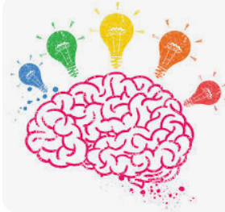
Why Do Some Teens Try Marijuana (Cannabis/THC)?
Notes:
Group Activity:
ASK THE QUESTION “Why Do Some Teens Try Marijuana?”
Ask students the question more specifically, “Why do you think some teens try marijuana after they have been given information about how risky marijuana use is?”
Brainstorm and write their answers on the board.
Discuss their answers.

Slide 21
Why Do Some Teens Try Marijuana (Cannabis/THC)?
Pressure from friends
Boredom Lack of confidence
Influence of media
To “fit in”
To do something they are not supposed to do
Curiosity
To deal with feelings Believe it’s safe
The Partnership to End Addiction
Notes:
Resume showing the complete slide.
STOP at “Believe it’s safe” to prevent going to the next slide.
Compare to the list the students created.
Discuss any reasons teens might try marijuana that haven’t already been mentioned.
Partnership to End Addiction
Why Teens Drink and Experiment with Drugs, April 2024
https://drugfree.org

Slide 22
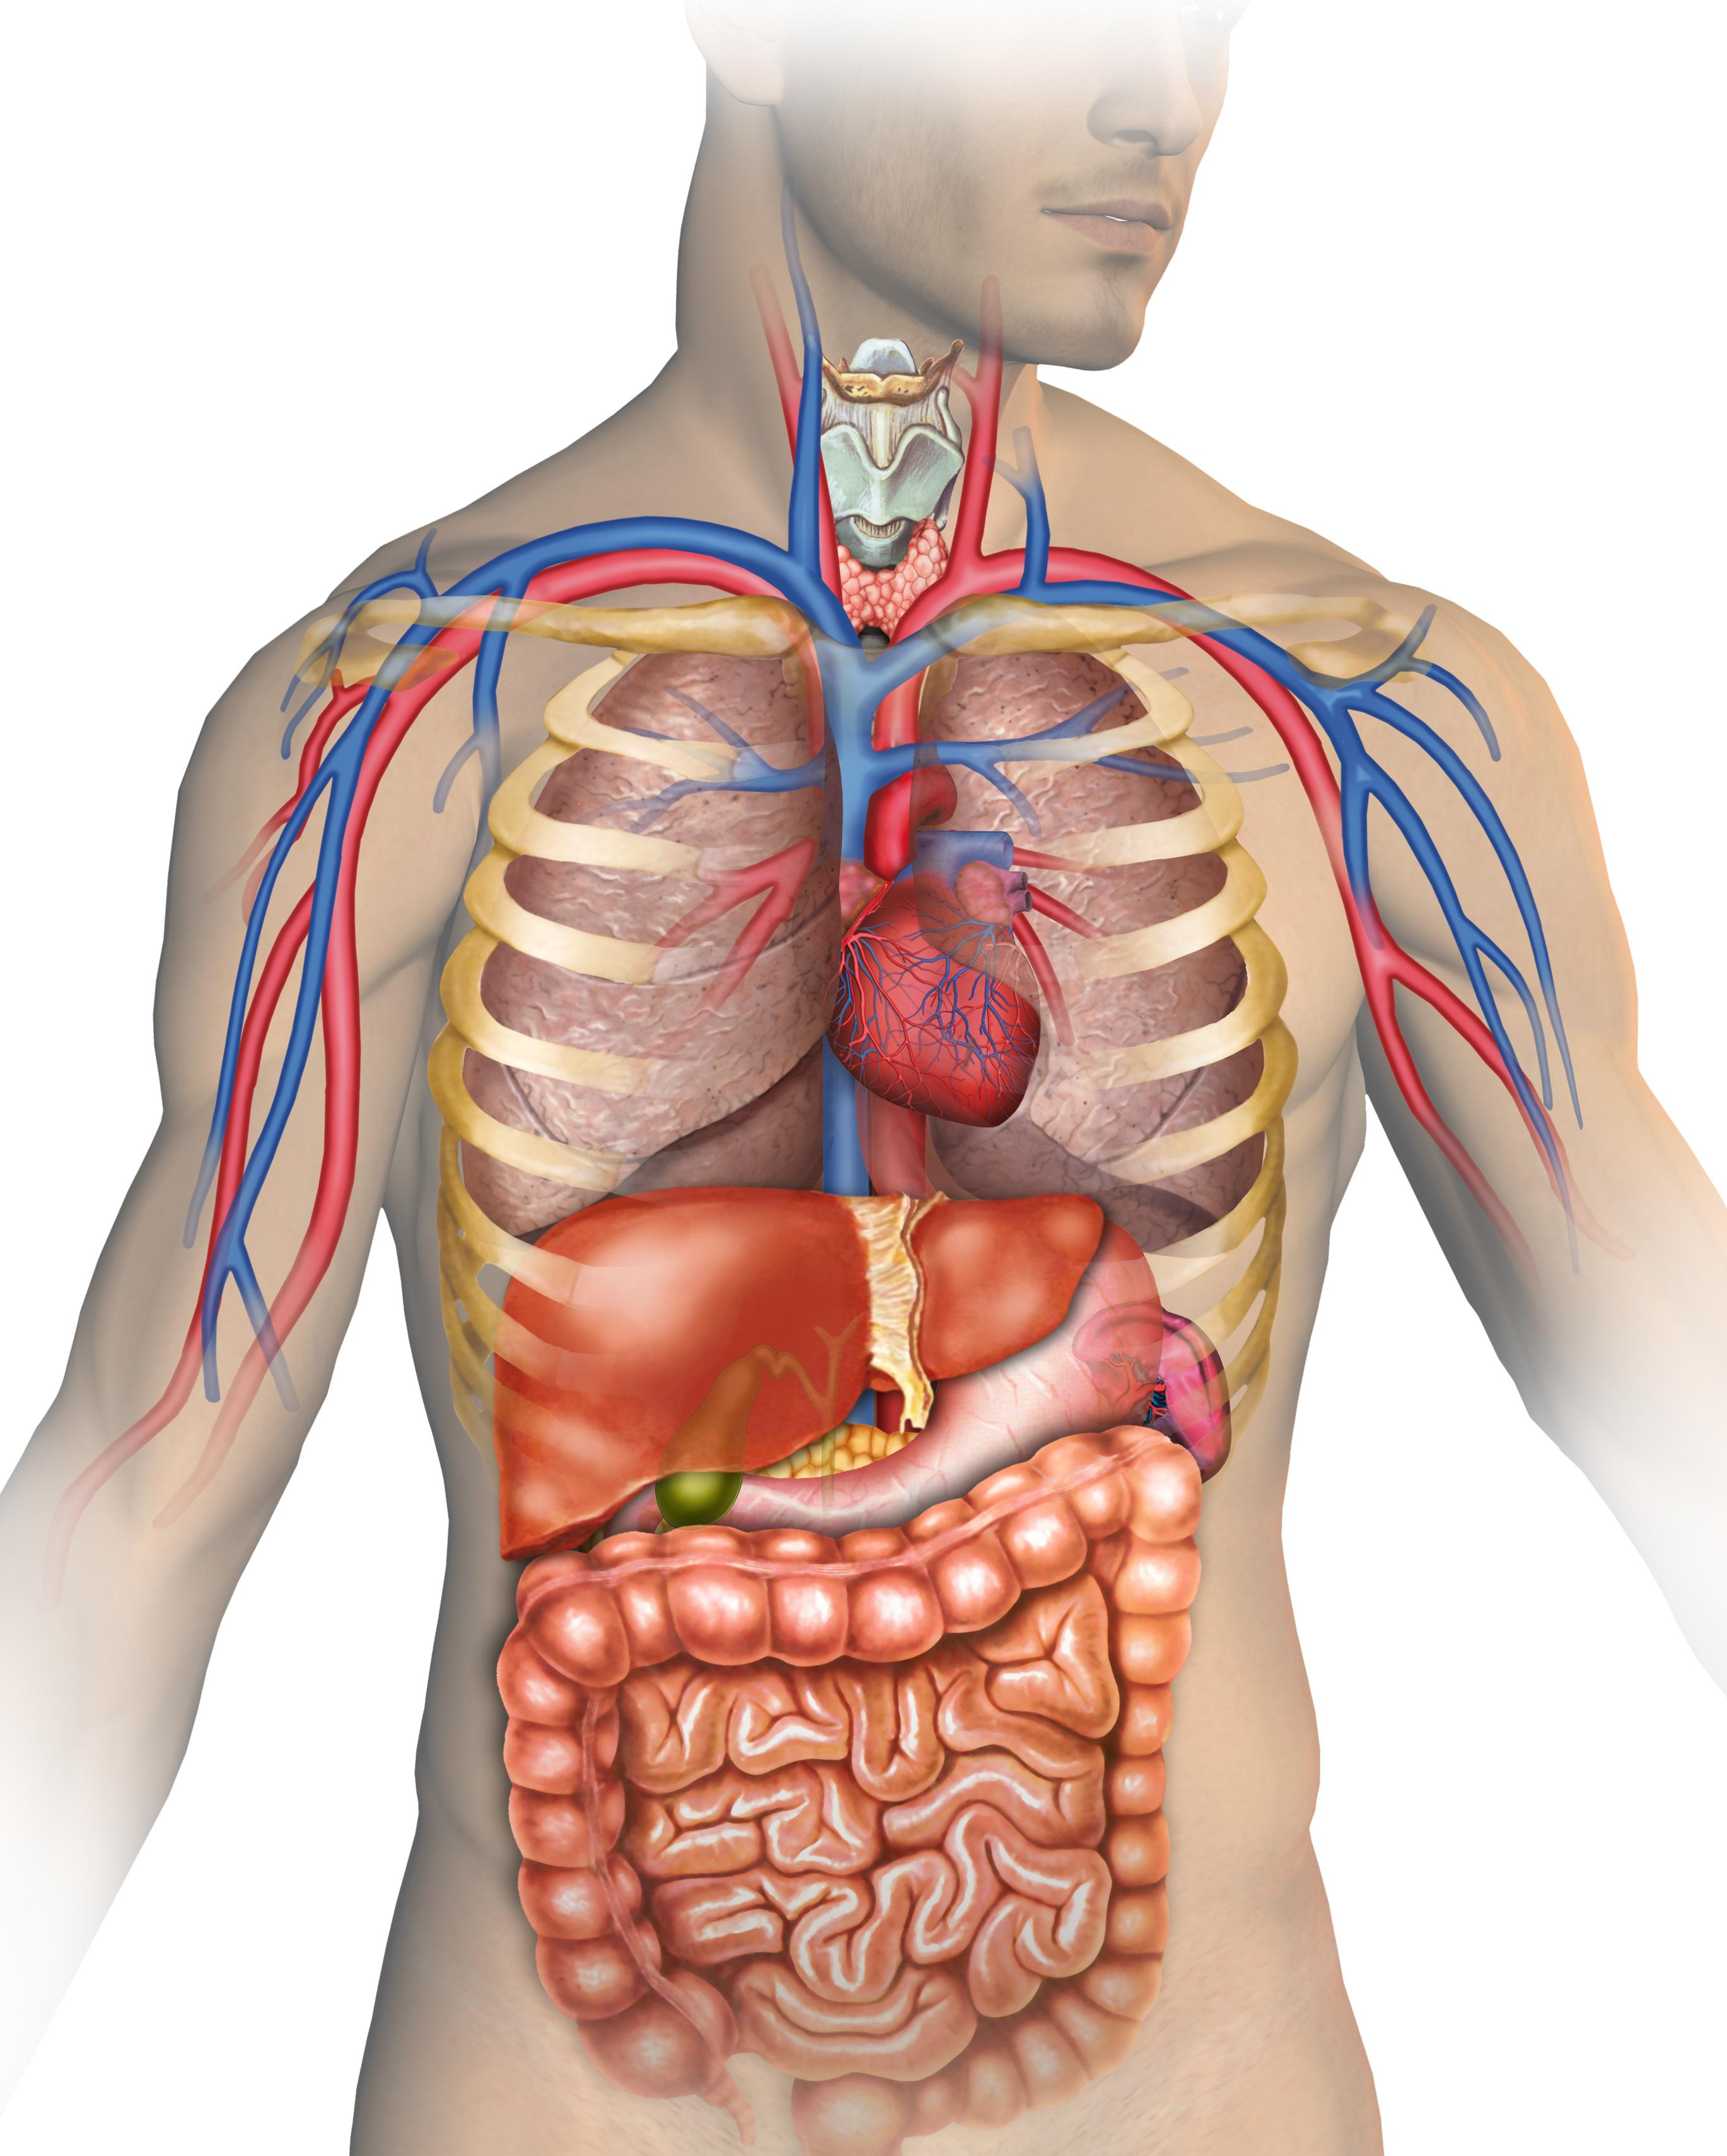
Marijuana (Cannabis/THC) & the Body
Using Marijuana (THC/Cannabis) can damage a person’s:
Heart
Lungs
Brain
CDC
Notes:
Teacher Comments:
Marijuana use can, over time, damage parts of the body.
Centers for Disease Control and Prevention
https://www.cdc.gov/cannabis/health-effects/index.html

Slide 23
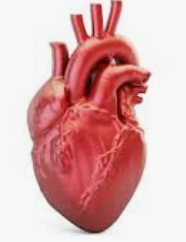
Marijuana (Cannabis/THC) & the Heart
Marijuana can make the heart beat faster and raise blood pressure immediately after using it.
Marijuana use can lead to increased risk of stroke and heart disease.
CDC
Notes:
Centers for Disease Control and Prevention
https://www.cdc.gov/cannabis/health-effects/heart-health.html
Teacher Notes:
Heart attack risk may be related to increased heart rate, as well as the effects of
marijuana on heart rhythms, causing quick and irregular heart beats.
This can be a frightening experience for the person using marijuana.

Slide 24
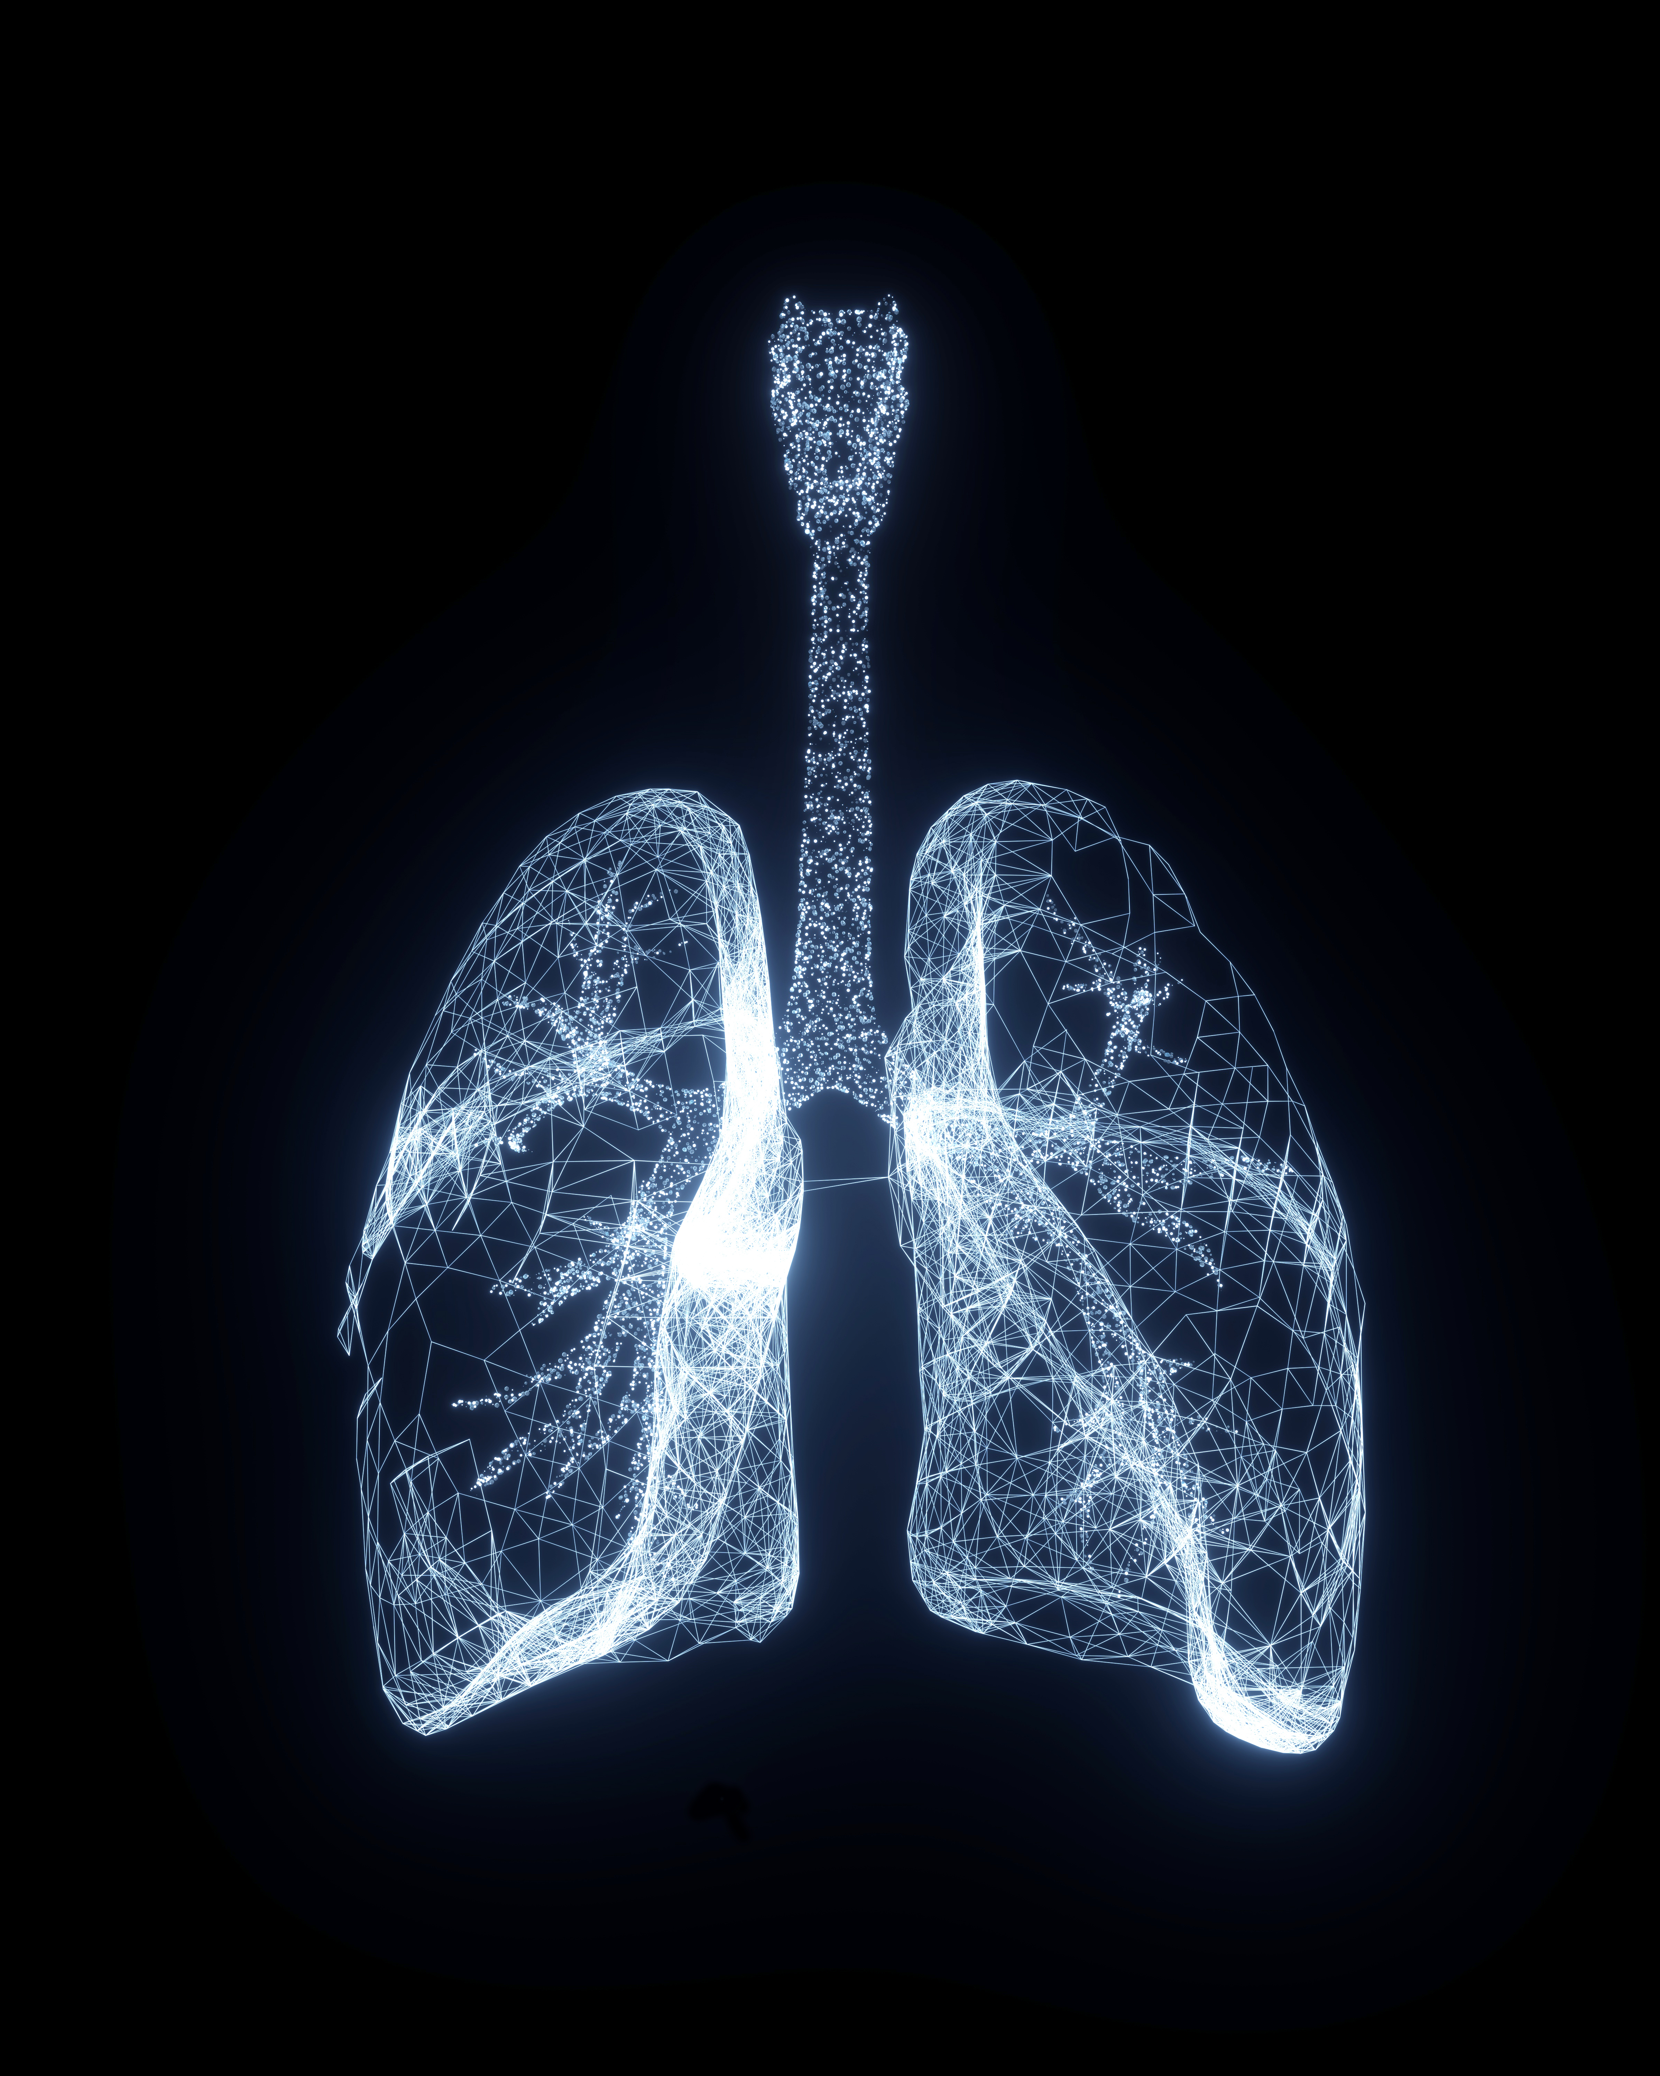
Marijuana (Cannabis/THC) & the Lungs
Research shows that vaping marijuana can cause lung damage.
Teens that vape marijuana are more likely to have breathing problems.
University of Michigan
Notes:
https://news.umich.edu/vaping-marijuana-associated-with-more-symptoms-of-lung-damage-than-vaping-or-smoking-nicotine/

Slide 25

Video (3:10 min.) Teen Brain Development
Notes:
Video: Click on the black box. Teen Brain Development (3:10 minutes)
https://www.youtube.com/watch?v=EpfnDijz2d8 (link to video if needed)
Teacher Notes:
NIDA explores in this video the intriguing similarities between the processes of brain development and computer programming.
The analogy helps us understand why toxic environmental factors like drugs, bullying, or lack of sleep can have such a long-lasting impact on a teenager’s life and can be used to empower your children or students with information they need make better decisions.

Slide 26

Marijuana (Cannabis/THC) & the Brain
Your brain is not fully
developed until you are
about 25 years or older.
Marijuana use can damage the developing brain, seriously affecting the ability to think, learn, remember, pay attention, and make safe decisions.
CDC
Notes:
https://www.cdc.gov/cannabis/health-effects/brain-health.html

Slide 27
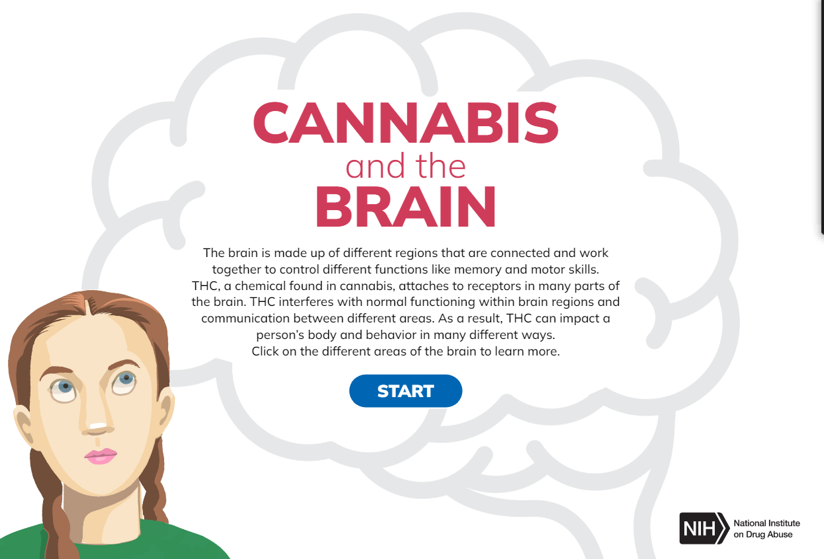
Activity: CANNABIS (Marijuana/THC) and the BRAIN
Notes:
Classroom Activity:
Click on the photo or the link in the slide to access the activity about the effects of marijuana on the brain.
When each of the red dots turns blue, you know you have completed each section of the brain.
Activity link: https://nida.nih.gov/themes/custom/solstice/interactive/cannabis/
To simplify the presentation, the parts of the brain are summarized below.
Cerebrum- the area that controls the ability to think, plan, solve problems, and make decisions
Basal Ganglia – area involved in movement, thinking, and emotion.
Limbic System - area involved in memory and emotion processing.
Brain Stem – area involved in vital life functions.
Cerebellum – area involved in motor skills, such as balance and coordination, and plays an important role in the perception of time.
When the screen says GREAT JOB, return to this PowerPoint.
This link can also be used to get to this activity.
https://nida.nih.gov/themes/custom/solstice/interactive/cannabis/

Slide 28
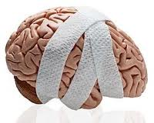
Marijuana (Cannabis/THC) & School
Marijuana’s negative effects on thinking, learning, memory, and attention can last for days and sometimes weeks—especially
if marijuana is
used often.
Addiction 2022
Notes:
Teacher Notes:
Someone who uses marijuana daily is likely to be functioning at a reduced intellectual level and experience problems learning.
https://onlinelibrary.wiley.com/doi/abs/10.1111/add.15764
Evidence on the acute and residual neurocognitive effects of cannabis use in adolescents and adults: a systematic meta-review of meta-analyses
Laura Dellazizzo, Stéphane Potvin, Sabrina Giguère, Alexandre Dumais
Addiction, Volume 117, Issue 7, July 2022 pp.1857-1870
Cognitive function deficits remain following a period of abstinence in individuals who initiated use in adolescence.
Volkow et al., 2016; Sachs, McGlade, & Yurgelun-Todd, 2015

Slide 29

Marijuana (Cannabis/THC) & School
Because of the effects on the developing brain, marijuana (THC/cannabis) users:
Have a harder time learning
Are more likely to get lower grades
Are more likely to drop out of school than non-users.
CDC
Notes:
Centers for Disease Control and Prevention
https://www.cdc.gov/cannabis/health-effects/cannabis-and-teens.html

Slide 30
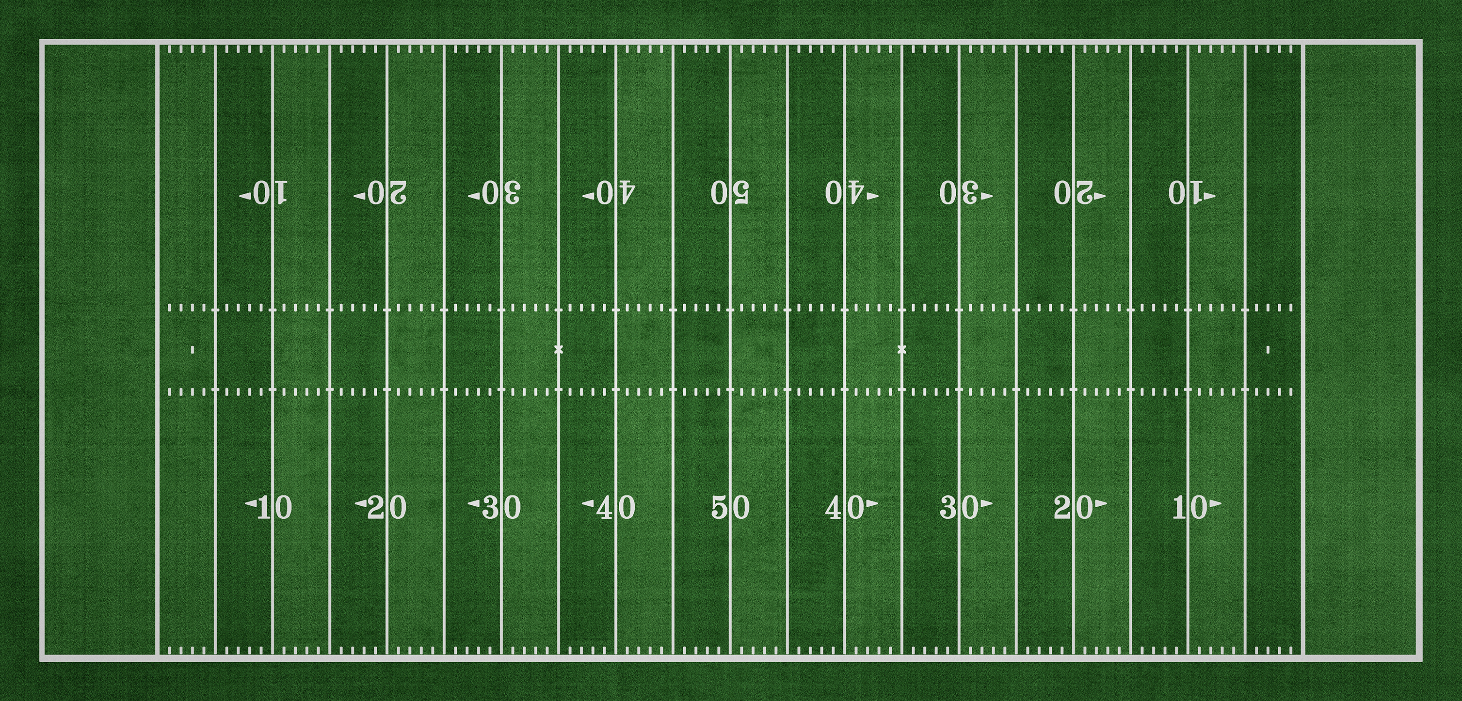

Marijuana (Cannabis/THC) & Sports
Marijuana use affects timing, movement, coordination, and concentration, and can interfere with athletic performance.
NCAA
Notes:
Classroom Activity:
Ask:
How many of you are part of a sports team?
How many hours a week do you practice during your season?
How important is it for you to be a good athlete?
Let’s review the effects of marijuana use on athletic performance.
Marijuana use:
Decreases eye-hand coordination
Slows reaction time
Reduces motor coordination
Slows reflexes
Impairs tracking ability and perceptual accuracy
Impairs concentration, and time appears to move more slowly
Causes short and long-term memory loss, "I can't remember the plays, coach"
Creates difficulty with thinking and problem solving,
Decreases motivation to perform and/or give maximum effort
Staying away from marijuana helps your team succeed.
https://www.samhsa.gov/marijuana
https://www.ncaa.org/news/2019/10/10/emerging-science-on-cannabis-marijuana-implications-for-student-athletes.aspx

Slide 31
Marijuana (Cannabis/THC) & Emotions
Regular use of marijuana (THC/cannabis) significantly increases a teen’s risk of depression and anxiety.
Marijuana (THC/cannabis) use can make depression, anxiety, and other emotional problems worse and has been linked to suicidal thoughts and psychosis (loss of touch with reality).
Marijuana (THC/cannabis) use can take away the desire to participate in activities and succeed in school.
CDC
Notes:
Teacher Comments:
Psychosis means that someone cannot tell the difference between what is real and what is not.
It is a very serious mental health problem that can be brought on by marijuana use in some situations.
Those that use marijuana in their teens are more likely to develop psychosis.
Use of high potency marijuana/THC products can produce strong fears and loss of touch with reality (delusions/hallucinations/panic).
This can be frightening and dangerous.
Teacher Notes:
Cannabis use can cause disorientation and sometimes unpleasant thoughts or feelings of anxiety and paranoia.
People who use cannabis are more likely to develop psychosis (not knowing what is real, hallucinations, and paranoia) and long-lasting mental disorders, including schizophrenia (a type of mental illness where people might hear or see things that are not really there).
Cannabis use is also associated with depression, social anxiety, and thoughts of suicide, suicide attempts, and suicide.
Centers for Disease Control and Prevention
https://www.cdc.gov/cannabis/health-effects/mental-health.html

Slide 32

Marijuana (Cannabis/THC) & Driving
Driving is a complex task that requires your full attention to stay safe and alert.
Marijuana use negatively affects skills needed to drive safely - alertness, concentration, coordination, and reaction time.
After using marijuana, it is hard to judge distances and react to signals and sounds on the road.
It is NOT safe to ride with someone who’s been using marijuana in any form.
CDC
Notes:
https://www.cdc.gov/cannabis/health-effects/driving.html Feb 2024

Slide 33
Marijuana (Cannabis/THC) & Driving
Driving under the influence (DUI) laws are not just for alcohol. Driving under the influence of drugs, including cannabis, is also dangerous and illegal.
Marijuana use before driving has resulted in serious auto accidents across Michigan.
University of Michigan Injury Prevention Center, 2020
Notes:
Teacher Comments:
After alcohol, marijuana is the substance most often associated with impaired driving.
Centers for Disease Control
https://www.cdc.gov/cannabis/health-effects/driving.html
Impact of Recreational Cannabis Legalization in Michigan: A Baseline Report. University of Michigan. Ann Arbor, MI. May 2020.
https://thenmi.org/reports/2020_IPC_Cannabis_Report_Michigan.pdf

Slide 34
ACTIVITY
If you have 10
high school students, how many of them do you think use marijuana?
Notes:
Group Activity (preparing students for the next slide):
Ask students – “If you have 10 high school students, how many of them do you think use marijuana?”
Write the estimates on the board.
Go to the next slide

Slide 35
National Monitoring the Future Survey (2024) University of Michigan
8th Graders | 10th Graders
More than 9 out of 10 had NEVER USED Marijuana | More than 8 out of 10 had NEVER USED Marijuana
Notes:
Teacher Comments:
Many people your age believe that most teens use marijuana, even though research shows that isn't true.
More than 9 out of 10 eighth grade students that took the national Monitoring the Future Survey in 2024 reported that they HAD NEVER used marijuana and more than 8 out of 10 tenth grade students that took the survey said they HAD NEVER used marijuana.
How does this compare to your guess?
MOST TEENS DO NOT USE MARIJUANA.
Teacher Notes:
The Monitoring the Future Survey is funded by the National Institute on Drug Abuse (NIDA), part of the National Institutes of Health (NIH). The survey is conducted by the University of Michigan.
To view full survey data, visit https://monitoringthefuture.org/wp-content/uploads/2024/12/mtf2025.pdf

Slide 36
REMEMBER…
Someone who uses drugs,
including marijuana (cannabis/THC), risks
hurting themselves physically & emotionally.
Marijuana (Cannabis/THC) use can have significant
negative effects on the developing brain, family
relationships, friendships, and the ability to
perform well in school and sports.
It’s important to find ways to manage feelings,
deal with stress, and have fun without
using marijuana, alcohol, vaping, or using other drugs..
Notes:
Teacher Notes:
This slide presents a summary of key issues related to teen marijuana use.
If you would like to provide your students with an informational sheet on managing difficult emotions, it can be accessed on the Kids Health website: https://kidshealth.org/en/teens/stressful-feelings.prt-en.html

Slide 37

REMEMBER…
MOST teens
DO NOT use marijuana (cannabis/THC).

Slide 38
Get The Facts…..
For more research-based information:
www.cdc.gov
www.nimh.nih.gov
www.cvcoalition.org
www.drugabuse.gov
Notes:
Teacher Comments:
There is much misinformation about marijuana. To learn the facts, visit any of these websites.
Check out the games, blogs, and interactive quizzes for your age.
Optional Assignment:
Give your students 10 minutes to explore one of these options and report back what they find.

Slide 39

Information Provided By:
The Chippewa Valley Coalition for Youth and Families joins School, Family, and Community in a partnership to promote healthy, resilient, and drug free youth and to prevent youth suicide.
www.cvcoalition.org

