Slide 1
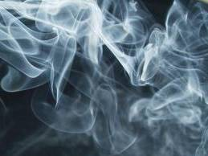
The Facts About Marijuana:
Information for Teens
Notes:
The Facts about Marijuana: Information for Teens was created by the
Chippewa Valley Coalition for Youth and Families, a school-community coalition in
mid-Macomb County, Michigan. It provides research-based information from
national sources, including the National Institute of Drug Abuse (NIDA),
the Community Anti-Drug Coalitions of America (CADCA), and others.
This lesson was piloted in 12 high school health classes and takes approximately 2 hours to
present, with discussion. It was reviewed by Nancy Buyle, School Safety/Student Assistance Consultant
at the Macomb Intermediate School District, and found to be compatible with the Michigan Model for
Health.
A Message to Teachers and Others Using The Facts About Marijuana: Information for Teens:
Many children and adolescents today have significant misperceptions and much
misinformation about marijuana.
National drug survey data, e.g., Monitoring the Future 2020, state survey data,
the Michigan Profile for Healthy Youth 2019-20,
show progressive declines in that perception of adolescents that marijuana use can be harmful.
The intention of this power point lesson, with video, is to provide accurate, research-based
information to educate youth about the real dangers of marijuana use, especially during adolescence.
This power point lesson is intended to be used as an instructional unit for students in high school health
or other classes and/or for educational presentations to youth groups in other settings,
e.g., churches, recreational centers, etc.
When some adolescents are provided with information about the dangers of marijuana use,
they may respond with adamant disbelief, given their lack of fact-based information
and the likelihood that some are marijuana users. In piloting this unit, we discovered that expressions
of disbelief can lead to stimulating and helpful discussions.
We have also found it constructive to take the following positions, in presenting this information:
I am not trying to convince you of anything. I am providing you with research-based information to consider.
You might do some research yourself to see what you discover, however, there is much misinformation
about marijuana on the internet. I can give you some reliable and research-based resources to review.
Be careful to separate opinion from research-based facts.
Information to Assist in Using The Facts about Marijuana: Information for Teens :
Many of the slides have accompanying information.
These include Teacher Notes that provide supplemental information for teachers.
Other slides may have Teacher Comments, statements found useful during the piloting of the curriculum
to enhance student learning. Some Teacher Comments are purposefully informal to be informal and “student friendly”.
In addition, some slides provide suggested Group Activities to promote discussion.
A Supplement to this Curriculum PowerPoint, Youth Marijuana Prevention Activities,
a Teaching Guide from the National Institute of Drug Abuse, is available at www.cvcoalition.org and provides
lesson plans and reproducible activities that can be used independently or as an enhancement to this lesson.
It contains a suggested activity to promote parent-student discussion.
A Bibliography/Resource List for The Facts about Marijuana: Information for Teens
is also available at these websites.
Presentation updated 11/2021

Slide 2
What is Marijuana?
Also called weed, pot, grass, herb, 420.
Marijuana is a mixture of the dried and shredded leaves, stems, seeds, and flowers of the cannabis sativa plant.
The mixture can be green,
brown, or gray.
Marijuana has a chemical in it called delta-9-tetrahydrocannabinol (THC) - the main addictive ingredient.
        NIDA
Notes:
A Reminder – some of the following slides have
TEACHER COMMENTS, statements that may be used in class to enhance the lesson, and/or
TEACHER NOTES, supplemental information for teachers
Teacher Notes:
Marijuana is a green, brown, or gray mixture of dried, shredded leaves, stems, seeds, and flowers of the hemp, or cannabis, plant.
It goes by many different names—pot, herb, weed, grass—and stronger forms include sinsemilla (sin-seh-me-yah),
hashish (“hash” for short), and hash oil.
Marijuana is often vaped and sometimes is mixed into foods, “edible marijuana”.
Many older users smoke marijuana in hand-rolled cigarettes called joints or some use pipes or water pipes called bongs.
Marijuana cigars, or blunts, are also used. To make blunts, users slice open cigars, remove some of the tobacco, and
mix the remainder with marijuana (Timberlake, 2009).
NIDA. 2019, December 24. Marijuana Drug Facts.
Retrieved from https://www.drugabuse.gov/publications/drugfacts/marijuana

Slide 3
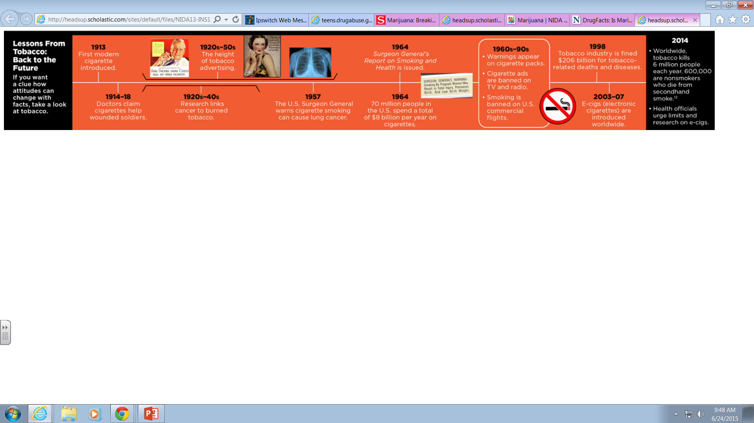
Lessons from Tobacco: A Look at History
Scholastic, NIDA, NIH, U.S. Department of HHS
Notes:
Teacher Comments:
Did you know that between 1914 – 1918 doctors mistakenly thought that tobacco could be used as medicine (see diagram)?
Did you know that from 1920 – 1950 many people smoked cigarettes and thought it was safe to do so?
People smoked openly in restaurants and public places. Most had ashtrays in their homes.
Movies, cartoons, advertisements often showed people smoking.
Group Activity:
Raise your hands if you believe that smoking tobacco cigarettes is dangerous. (Note that almost all or all hands are raised.)
What do you think happened to change people’s minds about smoking cigarettes between 1920 and today?
Allow class to brainstorm ideas – write them on the board if you choose.
Discuss the timeline on the slide noting:
1920’s - Research started that showed the danger of smoking tobacco
1957 - U.S. Surgeon General provides warning that smoking causing cancer
1960’s – 1990’s - warnings appear on packaging
EMPHASIZE THAT IT HAS TAKEN ALMOST 100 YEARS TO CHANGE ATTITUDES
ABOUT THE DANGERS OF SMOKING TOBACCO, DESPITE CLEAR EVIDENCE THAT IT IS DANGEROUS.
MANY PEOPLE DISREGARD THE DANGERS OF USING MARIJUANA TODAY.
HOPEFULLY, IT WILL NOT TAKE 100 YEARS TO RECOGNIZE THE DANGERS OF MARIJUANA USE.
Diagram taken from NIDA, National Institute of Health, U.S. Dept. of Health and Human Services included in
Scholastic Magazine, Heads Up Real News About Drugs and Your Body:
http://headsup.scholastic.com/sites/default/files/NIDA13-INS1_Stu-Mag_timeline.jpg

Slide 4

Marijuana is Not Safe
    Even though Michigan has legalized
    medical and retail marijuana,
    the facts are clear…
    Marijuana is NOT a safe drug,
    especially for teens and young adults.
Notes:
Teacher Comments:
In 2018, Michigan legalized the use of marijuana for individuals over the age of 21.
Although the laws regarding marijuana use have changed in several states over the past decade, marijuana remains classified as a Schedule I drug, meaning
that it is categorized as having a high potential for abuse and has no currently accepted medical use in treatment in the United States.
In other words, marijuana use remains illegal under federal laws in all states and the District of Columbia.
SAMHSA.gov 2016

Slide 5
Marijuana is Not Safe
    Not all plants are safe to smoke or ingest. (Tobacco is a plant.)
Oleander, Holly, and Lily of the Valley are a few of the hundreds of plants that are poisonous.
Poison.org
    Heroin, cocaine, cyanide and strychnine are all harmful substances made from plants.
    Centers for Disease Control
Notes:
This slide contains animations.
Each mouse click will advance to the next item on the slide.
Teacher Comments:
Some people might argue that marijuana is safe because it is a plant and is “natural”.
Consider that poison ivy is a plant that has negative effects just by touching it.
Some of you that have pets at home also know that there are dozens of house plants that
can harm your pet – even kill it.
https://www.poison.org/articles/plant#poisonousplants
www.cdc.gov

Slide 6

Marijuana is Not Safe
The percentage of THC found in marijuana has increased significantly over the years, making it a much more potent and addictive drug today than it was in past decades.
Notes:
Teacher Comments:
Delta-9-tetrahydrocannabinol (THC) is the main addictive ingredient in marijuana, responsible for many of its known effects.
Teacher Notes:
All forms of marijuana are mind-altering (psychoactive).
In other words, they change how the brain works. Marijuana contains more than 400 chemicals,
including THC (delta-9-tetrahydrocannabinol). Since THC is the main addictive chemical in marijuana,
the amount of THC in marijuana determines its strength or potency and therefore its effects.
The THC content of marijuana has been increasing since the 1980s.
NIDA. 2019, December 24. Marijuana Drug Facts.
Retrieved from https://www.drugabuse.gov/publications/drugfacts/marijuana

Slide 7

MARIJUANA HAS BECOME MUCH STRONGER OVER THE YEARS
Increased Addiction
Increased School Failure and Suspensions
Increased Emergency Room Visits
Increased Poison Control Calls
Rocky Mountain HIDTA Report
Notes:
This slide contains animations.
Each mouse click will advance to the next item on the slide.
Teacher Comments:
Addiction is a strong urge to keep taking a drug, even when it is causing harm
(problems in relationships, with academics, legal issues, emotional problems, etc.).
Further explanation of addiction is provided later in this power point.
Teacher Notes:
THC, the addictive element in marijuana, has increased significantly overtime.
Marijuana potency, as detected in confiscated samples, has steadily increased over the past few decades.
In the early 1990s, the average THC content in confiscated marijuana samples was less than 4%.
In 2018, it was more than 15%. Marijuana concentrates can have much higher levels of THC,
The increasing potency of marijuana, combined with the use of high-THC concentrates, raises concerns
that the consequences of marijuana use today could be worse than in the past, particularly among those who are new
to marijuana use and in young people, whose brains are still developing.
Marijuana concentrates, another form of marijuana, contain extremely high levels of THC (40%-90%)
and are used in various forms - food, drink, smoked, and vaped, increasing
the potential for addiction. Increases in marijuana potency may be the cause for a rise in emergency room visits.
NIDA. July 2020. Marijuana Research Report
https://www.drugabuse.gov/publications/research-reports/marijuana/letter-director

Slide 8
The Dangers of Marijuana Edibles
A single marijuana edible (e.g., cookies, candy bars, brownies) can have many times a “usual” dose of THC.
When marijuana edibles are used, the effects are delayed.
The most intense effects may not be felt for 3-4 hours after the edible is eaten.
Someone experimenting with marijuana edibles generally doesn’t feel the effects right away and may eat more to "get high." This leads to dangerous overdosing.
Notes:
This slide contains animations.
Each mouse click will advance to the next item on the slide.
https://www.healthychildren.org/English/ages-stages/teen/substance-abuse/Pages/Edible-Marijuana-Dangers.aspx

Slide 9

The Dangers of Marijuana Edibles
Consuming high potency edibles can result in overdose effects including:
  Intoxication/altered perception
  Anxiety/panic/paranoia
  Dizziness
  Weakness
  Slurred speech
  Poor coordination
  Increased heart rate/breathing problems
Notes:
This slide contains animations.
Each mouse click will advance to the next item on the slide.
https://www.healthychildren.org/English/ages-stages/teen/substance-abuse/Pages/Edible-Marijuana-Dangers.aspx

Slide 10

Marijuana Affects Each Person Differently
Effects will vary based on:
Biology (e.g., gender, weight, family history of addiction)
Strength or potency of the marijuana (how much THC it has)
User’s previous experience with the drug
Whether alcohol or other drugs are also used
How it is consumed (smoked/vaped/eaten)
NIDA
Notes:
Teacher Comments:
What happens if someone smokes marijuana?
Some people feel nothing at all when they smoke marijuana.
Others may feel relaxed or "high.“
Some experience sudden feelings of anxiety and paranoid thoughts
(even more likely with stronger varieties of marijuana).
Regular use of marijuana has also been linked to depression, anxiety, and a loss of drive
or motivation, which means a loss of interest even in previously enjoyable activities.
Its effects can be unpredictable, especially when other drugs are mixed with it.
When marijuana is smoked, THC rapidly passes from the lungs into the bloodstream,
which carries the chemical to the brain and other organs throughout the body.
It is absorbed more slowly when ingested in food or drink.
NIDA. 2019, December 24. Marijuana DrugFacts.
Retrieved from https://www.drugabuse.gov/publications/drugfacts/marijuana

Slide 11
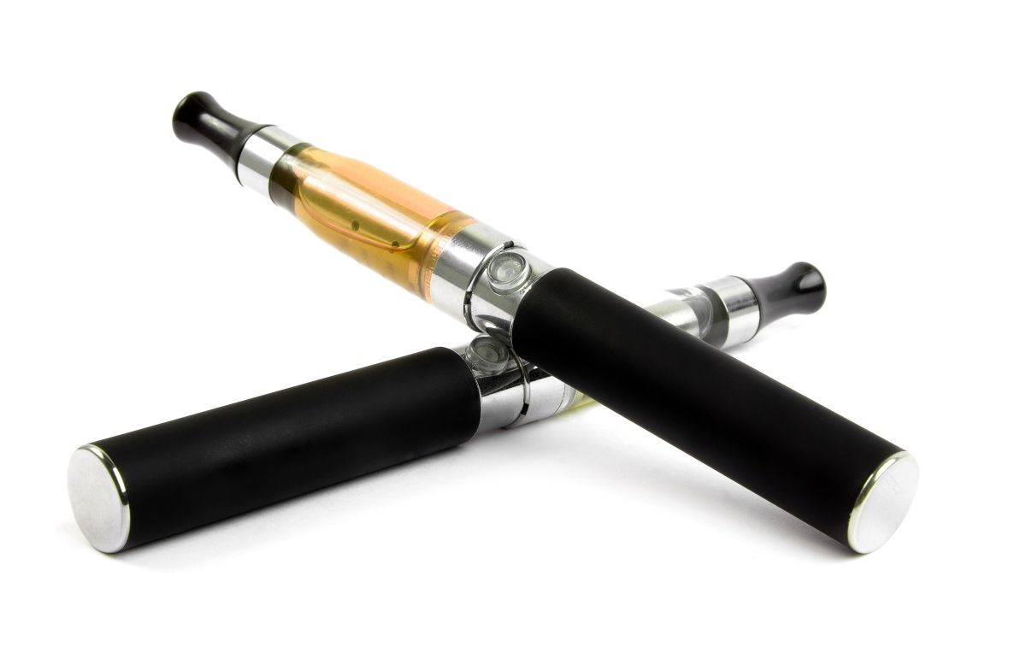
Is Vaping Marijuana Safer Than Smoking It?
Users inhale different chemicals when vaping marijuana.
Vaping products can contain dangerous chemicals and metal particles from the device itself.
Vaping high potency THC oils and concentrates increases the potential for addiction.
www.Learnaboutmarijuanawa.org
Notes:
This slide contains animations.
Each mouse click will advance to the next item on the slide.
Teacher Notes:
There are two types of products that can be vaporized -
marijuana oils (also called extracts or concentrates) and the marijuana plant (usually flowers/buds).
NIDA. 2019, December 24. Marijuana DrugFacts.
Retrieved from https://www.drugabuse.gov/publications/drugfacts/marijuana

Slide 12

Marijuana
Potential Short-Term Effects
Distorted perception of reality
Impaired short-term memory
Paranoia/panic attacks Risky/irresponsible behavior
Concentration & learning problems
Loss of physical & mental motivation Dry mouth & throat
Difficulty keeping track of time
Increased appetite
Impaired coordination and balance
NIDA
Notes:
This slide contains animations.
Each mouse click will advance to the next item on the slide.
Teacher Comments:
Remind students that they cannot control the effects marijuana will have on them
and that the effects may be different over time.
Some effects of the use of high potency marijuana can be frightening and dangerous.
Effects such as concentration/learning problems, motivation problems,
and paranoia/panic can last for days after marijuana is used.
Every time a drug is put into the body, a risk is taken.
Teacher Notes:
Users are not likely to experience ALL these effects EVERY time marijuana is used.
NIDA. 2019, December 24. Marijuana DrugFacts.
Retrieved from https://www.drugabuse.gov/publications/drugfacts/marijuana

Slide 13

Marijuana
Potential Long-Term Effects
Risk of Addiction
Permanent brain changes
Increased risk of depression, suicidal thoughts
Changes in appetite and sleeping patterns
Respiratory problems
Increased risk of cancer
NIDA
Notes:
This slide contains animations.
Each mouse click will advance to the next item on the slide.
Teacher Comments:
Explanation of Terms:
Addiction – Feeling a strong urge to keep taking a drug even when it is causing harm
problems in relationships, with academics, legal issues, emotional problems, etc.).
Further explanation of addiction is provided in the next 2 slides.
Someone who smokes marijuana regularly may have many of the same respiratory problems
that tobacco smokers do, such as daily cough, more frequent upper respiratory illnesses, and
a greater risk of lung infections like pneumonia. As with tobacco smoke, marijuana smoke consists
of a toxic mixture of gases and tiny particles, many of which are known to harm the lungs.
Although we don’t yet know if marijuana causes lung cancer, many people who smoke marijuana
also smoke cigarettes, which do cause cancer—and smoking marijuana can make it harder to quit tobacco use.
Marijuana has the potential to promote lung cancer and cancer in other parts of the respiratory tract because
it contains irritants and carcinogens—up to 70 percent more than tobacco smoke.
Teacher Notes:
Marijuana use can also create high levels of an enzyme that converts certain hydrocarbons into a
cancer-causing form, which could accelerate the changes that ultimately produce malignant cells.
Since marijuana smokers generally inhale more deeply and hold their breath longer than tobacco smokers,
the lungs are exposed longer to carcinogenic smoke. However, while several lines of evidence have suggested
that marijuana use may lead to lung cancer, the supporting evidence is inconclusive. The presence of an
unidentified active ingredient in cannabis smoke having protective properties—
if corroborated and properly characterized—could help explain the inconsistencies and modest findings.
NIDA. 2019, December 24. Marijuana DrugFacts.
Retrieved from https://www.drugabuse.gov/publications/drugfacts/marijuana
https://www.sciencenewsforstudents.org/article/concerns-explode-over-new-health-risks-vaping

Slide 14
Marijuana is Addictive
The National Institute of Health found that the EARLIER marijuana use begins, the GREATER the risk of drug abuse and addiction.
About 1 in 6 people who start using as a teen, and 25–50% of people who use it every day, become addicted to marijuana.
Research shows that approximately 9 percent, or about 1 in 11, of those who use marijuana will become addicted.
NIDA
Notes:
This slide contains animations.
Each mouse click will advance to the next item on the slide.
Teacher Notes:
Long-term marijuana use can lead to addiction; that is, people have difficulty controlling their drug use
and cannot stop even though use creates problems and interferes with many aspects of their lives.
It is estimated that 9% (about 1 in 11) of those who use marijuana will become dependent on it.
The number goes up to about 1 in 6 in those who start using young (in their teens) and to 25–50
percent (up to 5 out of 10) among daily users.
Addiction rates among those between 12 and 17 years are among the highest levels nationally
in states that have legalized medical marijuana and/or recreational marijuana programs.
NIDA. 2019, December 24. Marijuana DrugFacts.
Retrieved from https://www.drugabuse.gov/publications/drugfacts/marijuana

Slide 15
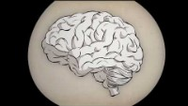
Video:
What is Addiction?
Notes:
PLEASE NOTE THAT VIDEO MAY ONLY PLAY IN “SLIDE SHOW” MODE. PLEASE ALLOW SEVERAL SECONDS FOR VIDEO TO LOAD.
This 3.17-minute video explains addiction.
Video Link: https://www.youtube.com/watch?v=MbOAKmzKmJo&t=1s

Slide 16

Marijuana Withdrawal Symptoms
Symptoms are similar in type and severity to those of nicotine withdrawal:
Irritability
Sleeping difficulties
Anxiety
Cravings
Symptoms can be the most intense a few days after marijuana use has stopped.
Withdrawal symptoms make it hard for someone to quit using marijuana.
NIDA
Notes:
NIDA. 2019, December 24. Marijuana DrugFacts.
Retrieved from https://www.drugabuse.gov/publications/drugfacts/marijuana

Slide 17
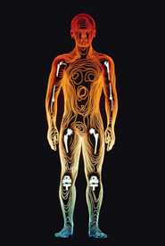
Marijuana & Your Body
THC (Delta-9 tetrahydrocannabinol) rapidly passes from the lungs into the bloodstream, which carries the chemical to organs throughout the body, including the brain.
THC is rapidly absorbed by fatty tissues in various organs, including the brain.
THC is released very slowly in the body over time.
NIDA
Notes:
This slide contains animations.
Each mouse click will advance to the next item on the slide.
NIDA. 2019, December 24. Marijuana DrugFacts.
Retrieved from https://www.drugabuse.gov/publications/drugfacts/marijuana

Slide 18
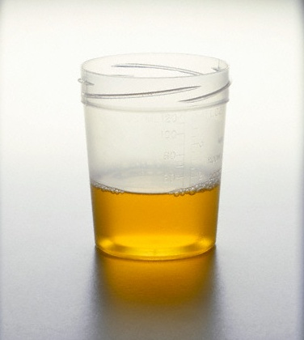
How long does THC stay in your system?
Notes:
Group Activity:
Have students suggest answers to the question, “How long does the THC in marijuana stay in your system?”
Write their answers on the board.
Comment on longest time and shortest time suggested by the class.
(The next slide provides the answer.)

Slide 19
How long can THC be detected?
Detection Time for Marijuana use:
One time use: 5 - 8 days
2-4x per month: 11 - 18 days
2-4x per week: 23 - 35 days
5-6x per week: 33 - 48 days
Daily Use: 49 - 63 days
Notes:
Teacher Notes:
Detection of THC in urine samples is not exact science.
The number of days THC can be detected varies,
based on THC content and the metabolism of person being tested.
Website: IPassedMyDrugTest.Com.:
http://www.ipassedmydrugtest.com/drug_test_faq.asp#detect_time

Slide 20
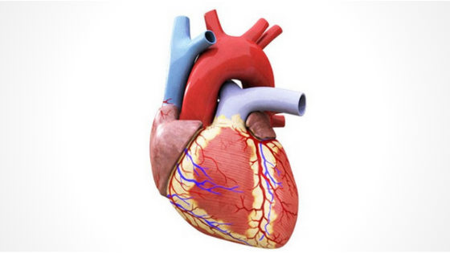
Marijuana & Your Body
The Heart
Normal heart rate is 70 to 80 beats per minute. Marijuana use can increase heart rate to up to 160 beats per minute.
This can result in a heart attack in an otherwise healthy person.
Taking other drugs with marijuana can increase this effect.
NIDA
Notes:
Teacher Notes:
Heart attack risk may be related to increased heart rate,
as well as the effects of marijuana on heart rhythms, causing palpitations and arrhythmias.
This risk may be greater in older individuals or in those with cardiac vulnerabilities.
NIDA. 2019, December 24. Marijuana DrugFacts.
Retrieved from https://www.drugabuse.gov/publications/drugfacts/marijuana

Slide 21
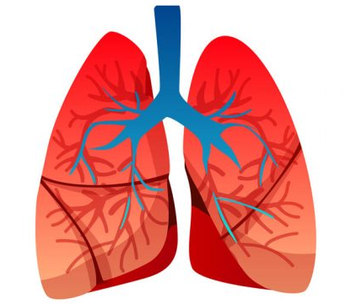
Marijuana & Your Body
The Lungs
Someone who smokes marijuana regularly can have many of the same breathing and lung problems as people who smoke tobacco.
Like tobacco smoke, marijuana smoke has a toxic mix of gases and tiny particles that can harm the lungs.
The long-term effects of vaping marijuana on the lungs are not currently known.
NIDA
Notes:
Teacher Notes:​
Marijuana smoke irritates the lungs, and people who smoke marijuana frequently
can have the same breathing problems as those who smoke tobacco.
These problems include daily cough and phlegm, more frequent lung illness,
and a higher risk of lung infections.
Researchers so far haven't found a higher risk for lung cancer in people who smoke marijuana.
Whether smoking marijuana causes lung cancer, as cigarette smoking does, remains an open question.
​
NIDA. 2019, December 24. Marijuana DrugFacts. ​
https://www.drugabuse.gov/publications/drugfacts/marijuana
​
​
​

Slide 22

Can Marijuana Use During Pregnancy Harm the Developing Baby?
YES
Research shows that children of mothers who used marijuana during pregnancy are more likely to have trouble with problem-solving, memory, and attention.
NIDA
Notes:
Teacher Notes:
It is conceivable that even low concentrations of THC, when administered during the perinatal period,
could have profound and long-lasting consequences for both brain and behavior.
Research has shown that some babies born to women who used marijuana during their pregnancies
display altered responses to visual stimuli, increased tremulousness,
and a high-pitched cry, which could indicate problems with neurological development.
In school, marijuana-exposed children are more likely to show gaps in problem solving skills,
memory, and the ability to remain attentive.
More research is needed, however, to disentangle the drug-specific factors from the environmental ones.
NIDA. 2019, December 24. Marijuana DrugFacts.
Retrieved from https://www.drugabuse.gov/publications/drugfacts/marijuana

Slide 23

Marijuana and the Teen Brain
Your brain is
“under construction”
- not fully developed -
until your mid 20’s.
Notes:
Teacher Notes:
How Does Marijuana Affect the Brain?
THC acts upon specific targets on brain cells, called cannabinoid receptors.
These receptors are ordinarily activated by chemicals similar to THC.
These are naturally occurring in the body and are part of a neural communication
network that plays an important role in normal brain development and function.
The highest density of cannabinoid receptors is found in parts of the brain that influence pleasure,
memory, thinking, concentration, sensory and time perception, and coordinated movement.
Marijuana over-activates this system, causing the high and other effects that users experience.
These include distorted perceptions, impaired coordination, difficulty with thinking and
problem solving, and disrupted learning and memory.
NIDA. 2019, December 24. Marijuana DrugFacts.
Retrieved from https://www.drugabuse.gov/publications/drugfacts/marijuana

Slide 24

Video: Guide to the Teen Brain
Notes:
PLEASE NOTE THAT VIDEO MAY ONLY PLAY IN “SLIDE SHOW” MODE. PLEASE ALLOW SEVERAL SECONDS FOR VIDEO TO LOAD.
This three-minute video explains brain development during the teen years, using
language students can understand.
National Institute on Drug Abuse
Video Link: https://www.youtube.com/watch?v=EpfnDijz2d8&t=1s

Slide 25
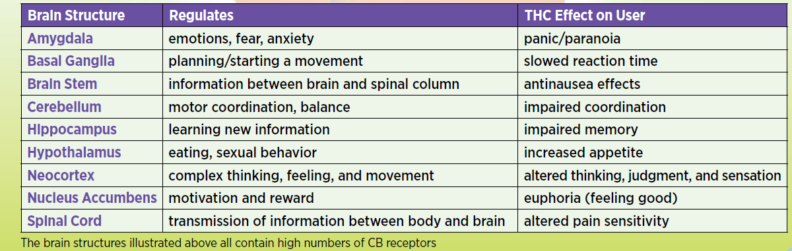
Marijuana:
Effects on the Teen Brain
S
Scholastic, NIDA, NIH, U.S. Department of HHS
Notes:
Teacher Comments:
Marijuana use negatively effects teen brain development.
A study by Children’s Hospital of Philadelphia and the National Institute on Mental Health,
found that adolescents and young adults who are heavy users of marijuana are
more likely than non-users to have disrupted brain development.
Researchers found abnormalities in areas of the brain that interconnect
brain regions involved in memory, attention, decision-making, language and executive functioning skills.
Diagram taken from NIDA, National Institute of Health, U.S. Dept. of Health and Human Services
included in Scholastic Magazine, Heads Up Real News About Drugs and Your Body

Slide 26
The Teen Brain & Decision Making
The Prefrontal Cortex is the decision -making area of your brain.
The THC in marijuana interferes with healthy decision making.
Scholastic, NIDA, NIH, U.S. Department of HHS
Marijuana use has been shown to negatively effect brain functions, such as attention, memory, learning and decision making. Those effects can last for days after the “high” wears off.
American Psychological Association
Notes:
This slide contains animations.
Each mouse click will advance to the next item on the slide.
Teacher Comments:
Decisions don’t “just happen” automatically.
Decisions you make result from a series of activities in the brain,
which happen almost instantaneously.
These activities in the brain involve a relay system in which different brain structures,
made up of specialized cells called neurons, ”talk” with each other by way of electrochemical
impulses and chemical messengers, called neurotransmitters.
THC in the brain interferes with this process.
The human brain is not fully developed until the mid-20’s or later,
which puts teens at a higher risk of making risky decisions.
NIDA, National Institute of Health, U.S. Dept. of Health and Human Services
included in Scholastic Magazine, Heads Up Real News About Drugs and Your Body .
https://www.apa.org/monitor/2015/11/marijuana-brain.aspx

Slide 27

Marijuana & Mental Health
Regular marijuana use has been linked to increased risk for depression, anxiety, suicidal thoughts, personality disturbances, and psychosis. NIDA
Notes:
Teacher Comments:
Anxiety and depression are the most common disorders of childhood.
Regular use, particularly of high potency marijuana, has been linked to these and other mental health disorders.
Much more research needs to be done to discover the connection between marijuana and mental health.
A reminder about suicidal thoughts –
if you or anyone you know is experiencing suicidal thoughts it is very important to talk with an adult you trust.
https://www.drugabuse.gov/publications/research-reports/marijuana/
there-link-between-marijuana-use-psychiatric-disorders

Slide 28
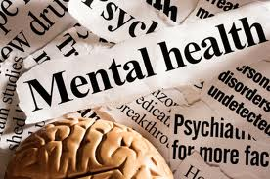
Marijuana & Psychosis/ Panic
Using high potency marijuana can cause psychosis (distorted perceptions, disturbing thoughts, paranoia) or panic.
Some users have an acute psychotic reaction or panic attack under the influence of marijuana.
NIDA
Notes:
Teacher Comments:
Scientists do not yet know if marijuana use causes lasting mental illness.
Marijuana use can worsen psychotic symptoms in people who already have schizophrenia,
a form of mental illness and can increase the risk of long-lasting psychosis in some people.
NIDA. 2019, December 24. Marijuana DrugFacts.
Retrieved from https://www.drugabuse.gov/publications/drugfacts/marijuana

Slide 29

Why Do Teens Use Marijuana?
Pressure from friends
Boredom
To experiment
Influence of media
To “fit in”
To rebel
To deal with feelings
Curiosity Believe it’s safe
NIDA
Notes:
This slide contains animations.
Each mouse click will advance to the next item on the slide.
Group Activity: STOP THIS SLIDE AFTER THE QUESTION “Why Do Teens Use Marijuana?”.
Ask students the question more specifically,
“Why do you think teens would try marijuana after they have been given information about how risky marijuana use is?”
Remind them about the drug prevention/education programming they received in elementary/middle schools,
e.g., DARE, Smart Moves, middle school health class, etc.
Brainstorm and write their answers on the board.
Discuss some of their answers.
Resume showing the complete slide (STOP at “Believe it’s safe”) .
Note and discuss any reason why teens use marijuana that hasn’t been mentioned.
NIDA. 2020, May 28. A Letter to Parents.
Retrieved from https://www.drugabuse.gov/publications/marijuana-facts-parents-need-to-know/letter-to-parents

Slide 30

Marijuana use can close the door to your future!
Marijuana use can take away the drive to be involved in activities and to succeed in school (called amotivational syndrome).
NIDA
Notes:
Teacher Notes:
Marijuana has also been associated with an amotivational syndrome,
defined as a diminished or absent drive to engage in typically rewarding activities.
Because of the role of the endocannabinoid system in regulating mood and reward, I
t has been hypothesized that brain changes resulting from early use of
marijuana may underlie these associations, but more research is needed to verify
that such links exist and better understand them.
https://www.drugabuse.gov/publications/research-reports/marijuana/
there-link-between-marijuana-use-psychiatric-disorders

Slide 31

Marijuana & School
Marijuana has negative effects on attention, motivation, memory, and learning that can last for days after the drug's immediate effects wear off—especially in people who use regularly.
NIDA
Notes:
Teacher Comments:
Someone who uses marijuana frequently may be functioning at a reduced intellectual
level most or all the time.
NIDA. 2020, May 28. A Letter to Parents.
Retrieved from https://www.drugabuse.gov/publications/marijuana-facts-parents-need-to-know/letter-to-parents

Slide 32

Marijuana & School
Students who use marijuana are FAR MORE likely to drop out of high school & MUCH LESS LIKELY to get a college degree.
Notes:
Teacher Comments:​
​
​
Marijuana is associated with school failure.
Marijuana has negative effects on attention, motivation, memory, and learning ​
that can persist after the drug's immediate effects wear off—especially in regular users. ​
Someone who smokes marijuana daily may be functioning at a reduced intellectual level
most or all the time. ​
Recent research suggests that people who begin using marijuana heavily
as teens may permanently lose an average of 8 points in IQ by mid-adulthood. ​
Compared with their nonsmoking peers, students who smoke marijuana tend to
get lower grades and are more likely to drop out of high school. ​
​
​
NIDA. 2020, May 28.
A Letter to Parents.
Retrieved from https://www.drugabuse.gov/publications/marijuana-facts-parents-need-to-know/letter-to-parents

Slide 33

Marijuana & Sports
Marijuana use affects timing, concentration, balance, movement, and coordination, which can significantly harm athletic performance.
Notes:
​Teacher Comments:
Marijuana can substantially decrease performance,
given its proven negative effects on the mental and physical skills
involved in playing a sport.
NIDA. 2019, December 24. Marijuana Drug Facts. ​
https://www.drugabuse.gov/publications/drugfacts/marijuana

Slide 34
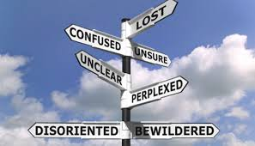
Marijuana & the Future
Longtime marijuana users report:
less satisfaction with their lives
memory and relationship problems
poorer mental and physical health
lower salaries
less career success
        NIDA
Notes:
This slide contains animations.
Each mouse click will advance to the next item on the slide.
Teacher Notes:
Long-term marijuana users report decreased overall life satisfaction, including diminished mental
and physical health, memory and relationship problems, lower salaries, and less career success.
NIDA. 2019, December 24. Marijuana DrugFacts.
Retrieved from https://www.drugabuse.gov/publications/drugfacts/marijuana
NIDA. 2020, May 28. A Letter to Parents.
Retrieved from https://www.drugabuse.gov/publications/marijuana-facts-parents-need-to-know/letter-to-parents

Slide 35
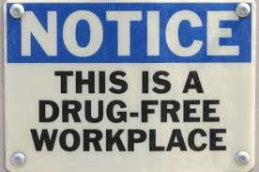
Employment & Marijuana Use
Legalization of medical and recreational marijuana in Michigan DOES NOT protect job applicants or workers that test positive for marijuana on workplace drug testing.
Someone can still get fired or not be hired for a positive drug test.
Notes:
Michigan Proposal 1, Marijuana Legalization Initiative (2018)
https://www.michigan.gov/documents/sos/Full_Text_-_CRMLA_635255_7.pdf

Slide 36

Financial Aid & College Scholarships
Colleges have different rules about scholarship requirements.
Some may not allow a student to apply for scholarships if he/she has a conviction for a drug offense.
Don’t take the risk of being unable to go to the school of your choice or losing your scholarship.
Notes:
Teacher Comments:
As part of the Free Application for Federal Student Aid (FAFSA) process, students convicted of a drug offense
must complete an eligibility worksheet that will determine if they are eligible,
partially eligible, or ineligible for student aid.
https://www.justthinktwice.gov/you-might-lose-your-student-loans-or-scholarship-drug-use

Slide 37
Group Activity
“
Estimate the percentage of 10th and 12th graders that reported using marijuana in the 30 days before taking a national drug survey.
Notes:
Group Activity (Preparing students for next slide):
Estimate the percentage of 10th and 12th graders that reported using marijuana in the 30 days before taking a national drug survey.
Write the estimated percentages on the board.
(The next slide provides the answer.)
The survey is the Monitoring the Future Survey conducted by the University of Michigan each year.

Slide 38
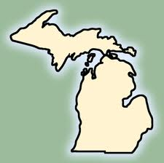
Monitoring the Future Survey (2020)
30 Days Before the Survey | 10th Graders | 12th Graders
Did NOT Use Marijuana | 83.4% | 78.9%
Notes:
Teacher Comments:
More than 8 out of 10 tenth grade students that took the national Monitoring the Future Survey
in 2020 reported that they DID NOT use marijuana in the month prior to the survey.
Nearly 8 out of 10 twelfth graders that took the survey said they DID NOT use marijuana in the last 30 days.
Teacher Notes:
Tenth and twelfth grade students in the U.S. that took the Monitoring the Future Survey in 2020
reported past 30-day marijuana use of 16.6% for 10th grade and 21.1% for 12th grade.
Since 1975 the MTF survey has measured drug and alcohol use and related attitudes
among adolescent students nationwide. Survey participants report their drug use behaviors
across three time periods: lifetime, past year, and past month.
Overall, 11,821 students from 112 public and private schools participated in the
2020 Monitoring the Future survey. The survey is funded by the NIDA, a component of the
National Institutes of Health (NIH), and conducted by the University of Michigan.
To view full survey data, visit https://www.drugabuse.gov/drug-topics/trends-statistics/monitoring-future

Slide 39

Marijuana & Driving
Marijuana is a drug commonly involved in fatal car accidents.
Marijuana negatively affects skills needed for safe driving—alertness, concentration, coordination, and reaction time.
Marijuana makes it hard to judge distances and react to signals and sounds on the road.
It’s not safe to drive high or to ride with someone who’s been using marijuana.
NIDA
Notes:
This slide contains animations.
Each mouse click will advance to the next item on the slide.
NIDA. 2019, December 24. Marijuana DrugFacts.
Retrieved from https://www.drugabuse.gov/publications/drugfacts/marijuana

Slide 40
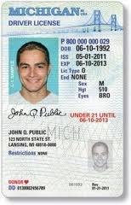
Even though recreational marijuana is legal in Michigan, there are serious consequences for underage use (under 21 years)…
A marijuana conviction delays getting a driver’s license.
Marijuana use/possession results in an automatic 6 months suspension of a driver’s license - whether use/possession was
in a car or not.
Notes:
This slide contains animations.
Each mouse click will advance to the next item on the slide.
Teacher Notes:
Michigan is state with zero tolerance when it comes to being under the influence of drugs,
including marijuana, while operating a vehicle.
If a police officer has reason to believe someone has smoked or ingested any amount of marijuana,
that person can be charged with OWI (Operating Under the Influence).
This is even true even if the persons no longer feels under the influence or has been certified to use medical marijuana.
http://www.mymichigandefenselawyer.com/michigan-criminal-laws/marijuana-possession/

Slide 41
Even though recreational marijuana is legal in Michigan, there are serious consequences for driving under the influence…
A person can be charged with operating while intoxicated, often called OWI or DUI, for being under the influence of drugs, including marijuana.
The penalties can include jail time, fines, license suspension, community service, and/or completion of a drug rehabilitation program.
Notes:
This slide contains animations.
Each mouse click will advance to the next item on the slide.
http://www.mymichigandefenselawyer.com/michigan-criminal-laws/marijuana-possession/

Slide 42
Some Facts about Michigan’s
Medical Marihuana Act
  Medical Marijuana use is not allowed:
  While operating a car or any other motor vehicle, aircraft, or motorboat
  In a public place or on any form of public transportation, including a school bus
  In schools
  In a correctional facility
Michigan Medical Marihuana Act 2008
Notes:
Teacher Comments:
Sometimes people believe that there are no restrictions for medical marijuana use in the community.
This is not true.
Michigan Medical Marihuana Act 2008
http://www.legislature.mi.gov/(S(gpaghb2gfee2j0aattngi4eu))/
mileg.aspx?page=getobject&objectname=mcl-Initiated-Law-1-of-2008&query
=on&highlight=medical%20AND%20marihuana

Slide 43
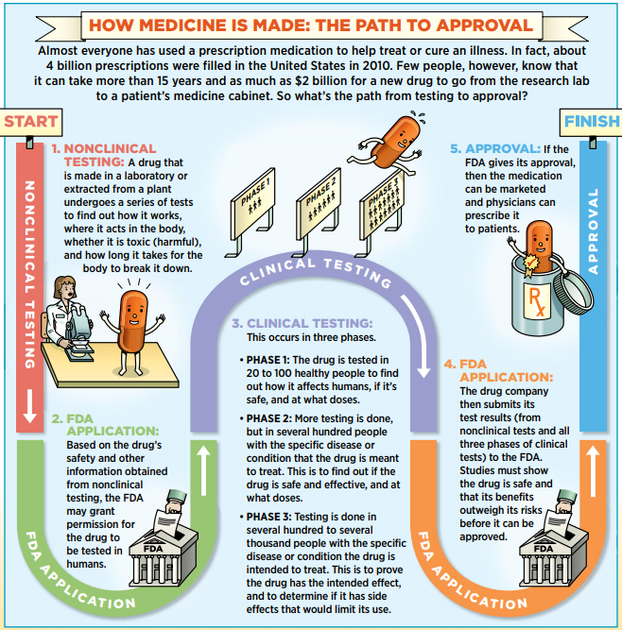
FDA: How Medicine is Approved
Notes:
Teacher Comments:
Using marijuana as medicine does not make it medicine.
It has not gone through the Food and Drug Administration’s (FDA)
approval process to show that its benefits outweigh its risks.
Teacher Notes:
The FDA has approved some medications made from marijuana
e.g., Marinol, Sativex, and Epidiolex, that contain chemicals in marijuana, including CBDs,
a chemical that does not create a high.
New medications that act on the cannabinoid system (where the THC in marijuana acts)
are being developed to treat a variety of symptoms, but with fewer side effects than smoked marijuana.
http://www.scholastic.com/smp/pdfs/nida/NIDA10-INS3_Stu%20Mag.pdf

Slide 44
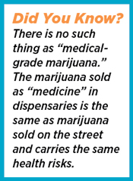
Smoked Marijuana is NOT Medicine
Some people may get relief from some symptoms of severe illnesses by smoking marijuana, BUT… Using marijuana as medicine DOESN’T make it medicine.
Scholastic, NIDA, NIH, U.S. Department of HHS
Notes:
This slide contains animations.
Each mouse click will advance to the next item on the slide.
Teacher Notes:
Additional information can be found about using marijuana as medicine:
https://www.drugabuse.gov/publications/research-reports/marijuana/marijuana-safe-effective-medicine

Slide 45
Marijuana Matters –
The Facts
Any time you put drugs in your body, you risk serious physical and emotional damage.
Drug use, including use of marijuana, can have significant negative effects on your family relationships, friendships, school and athletic performance, and your future.
It’s important to find ways to manage feelings, deal with stress, and have fun without using drugs.
MOST TEENS DO NOT USE MARIJUANA, ALCOHOL, OR OTHER DRUGS.
Notes:
This slide contains animations.
Each mouse click will advance to the next item on the slide.

Slide 46

MOST teens DO NOT use marijuana.
Notes:
PLEASE NOTE THAT VIDEO MAY ONLY PLAY IN “SLIDE SHOW” MODE. PLEASE ALLOW SEVERAL SECONDS FOR VIDEO TO LOAD.
This motivational video is 3.51 minutes long.
It emphasizes the importance of making good decisions.
Video Link: https://www.youtube.com/watch?v=nFhGZdo5mrI&t=1s
Teacher Notes:
Students typically believe that “everyone” uses, even though research does not support that perception.
Group Activity:
Ask students – “Think about times when you have heard other students ‘brag’ about their drug use.”
Ask your students to consider – “There might be 1 student in the entire class who is vocal about their use.”
Other students get the idea that drug use is more common than it really is.”
Then ask – “Have you ever observed a student ‘brag’ that he/she did NOT use marijuana?”
Comment – “While most students do not use marijuana, they are not likely to ‘brag’ about it.”

Slide 47

Get The Facts…
For more research-based information:
www.drugabuse.gov
www.teens.drugabuse.gov
www.cadca.org
www.nimh.nih.gov
www.niaaa.nih.gov
Notes:
Teacher Note:
Encourage students to go to one or more of these websites to check out the “cool” games,
fact sheets, blogs, and interactive quizzes for teens.

