Slide 1

Clearing the Smoke for Middle School Students: The Truth About Marijuana
Notes:
Information for Teachers
Clearing the Smoke for Middle School Students: The Truth About Marijuana was created by the Chippewa Valley Coalition for Youth and Families, a school-community coalition in mid-Macomb County Michigan.
It provides research-based information from national sources, including the National Institute of Drug Abuse (NIDA), National Institute of Health, and others.
It was reviewed by Sara Orris, Health Consultant at the Macomb Intermediate School District, and determined to be compatible with the Michigan Health Model.
This lesson was piloted in middle school health classes in Chippewa Valley Schools.
Presentation takes approximately 1 hour with discussion.
A Message to Teachers and Others Using this Lesson:
Many youth today have significant misperceptions and much misinformation about marijuana.
National drug survey data, e.g. Monitoring the Future 2020, state survey data, the Michigan Profile for Healthy Youth 2020, show progressive declines in the perception of risk of harm for marijuana use for adolescents.
There is a correlation between the decline of perception of risk and increased use of any drug.
The intention of this PowerPoint, with videos, is to provide accurate, research-based information to educate youth about the real dangers of marijuana use, especially within adolescence.
This PowerPoint is intended to be used as an instructional unit for students in middle school health or other classes.
It can also be used for educational presentations to youth groups in other settings, e.g. churches, recreational centers, etc.
When some youth are provided with information about the dangers of marijuana use, they may respond with adamant disbelief, given their lack of factual information and the likelihood that some are marijuana users.
In piloting this unit, we discovered that expressions of disbelief can lead to stimulating and helpful discussions. We have also found it constructive to take the following positions, in presenting this information:
I am not trying to convince you of anything. I am providing you with research-based information to consider.
You might do some research yourself to see what you discover, however, there is much misinformation about marijuana on the internet.
I can give you some reliable and research based resources to review. (See downloadable resource list in the Mobilizing Michigan Tool Kit)
Be careful to separate opinion from research based facts.
Information to Assist in Using this PowerPoint:
Many of the slides have accompanying information.
These include Teacher Notes that provide supplemental information for teachers.
Other slides have Teacher Comments, statements found useful during the piloting of the curriculum to enhance student learning.
Some Teacher Comments are purposefully informal to be “student friendly”.
In addition, some slides will provide suggested Group Activities to promote discussion.
A Bibliography/Resource List for Clearing the Smoke for Middle School Students: The Truth About Marijuana, Supplemental Marijuana Prevention Activities. Separate Teacher Notes can be accessed by registering for the Mobilizing Michigan…Protecting Our Kids from Marijuana Tool Kit, available at www.cvcoalition.org.

Slide 2
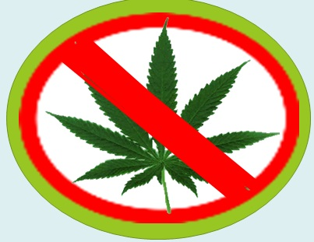
What is Marijuana?
Also called weed, pot, grass, dope, bud, 420
Marijuana is a mixture of the dried and shredded leaves, stems, seeds, and flowers of the cannabis sativa plant. The mixture can be green, brown, or gray.
NIDA
Notes:
A reminder – some of the following slides will have TEACHER COMMENTS, statements that may be used in class to enhance the lesson, and/or TEACHER NOTES, supplemental information for teachers.
Teacher Notes:
Vaping marijuana and using marijuana edibles are becoming the preferred delivery method for youth and adults.
Marijuana: Facts for Teens, 2017, National Institute on Drug Abuse (NIDA)
https://d14rmgtrwzf5a.cloudfront.net/sites/default/files/marijuana_teens.pdf

Slide 3
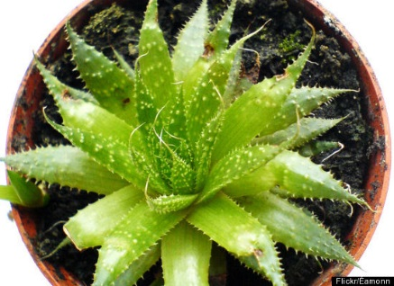

Marijuana is NOT safe
Not all plants are safe to smoke or eat. (Tobacco is a plant.)
There are dozens of household plants that can poison people and pets (like Aloe Vera and Daffodils). Center for Disease Control (CDC)
Heroin, cocaine, cyanide and strychnine are all dangerous substances made from plants.
Human Relations Media: Gateway Drugs and Beyond
Notes:
Some students might argue that marijuana is safe because it is a plant and is “natural”.
Teacher Comments:
Consider that poison ivy is a plant and even touching it has negative effects.
Some of you that have pets at home know that there are dozens of house plants that can harm your pet.
http://www.cdc.gov/niosh/topics/plants/

Slide 4

What is Marijuana?
Marijuana has a chemical in it called delta-9-tetrahydrocannabinol (THC) - the main psychoactive (i.e., mind altering) ingredient.
THC
Notes:
Teacher Comments:
Marijuana contains more than 400 chemicals, including THC (delta-9-tetrahydrocannabinol).
THC (Delta-9-tetrahydrocannabinol), the main chemical in marijuana, is the part that creates addiction.
Marijuana Drug Facts, December 2019, National Institute on Drug Abuse (NIDA)
http://www.drugabuse.gov/publications/drugfacts/marijuana
Teacher Notes:
When marijuana is smoked or vaped, the effects begin almost immediately.
THC rapidly passes from the lungs into the bloodstream, which carries the chemical to organs throughout the body, including the brain.
THC in edible marijuana (food and beverages) enters the bloodstream much slower through the liver. More information can be found in slide 12.
All forms of marijuana are mind-altering (psychoactive). In other words, they change how the brain works. Since THC is the main active chemical in marijuana, the amount of THC in marijuana determines its strength or potency and therefore its effects. The THC content of marijuana has been increasing since the 1980s.
Marijuana: Facts for Teens, 2017, National Institute on Drug Abuse (NIDA)
https://d14rmgtrwzf5a.cloudfront.net/sites/default/files/marijuana_teens.pdf
Marijuana Drug Facts, December 2019, National Institute on Drug Abuse (NIDA)
http://www.drugabuse.gov/publications/drugfacts/marijuana

Slide 5

“Medical” Marijuana
All prescription medication used in our country needs to be approved by a government agency, the Federal Drug Administration (FDA).
The FDA makes sure that medications are safe and effective AND that the benefits are greater than the risks.
The FDA has not approved smoked or edible marijuana as medicine because it has not been determined that the benefits outweigh the risks.
SCHOLASTIC, NIDA, NIH, U.S. DEPARTMENT OF HHS
Notes:
http://www.scholastic.com/smp/pdfs/nida/NIDA-YR10-Stu_Comp.pdf
Teacher Notes:
The study of marijuana in clinical trial settings is needed to assess the safety and effectiveness of marijuana for the treatment of any disease or condition: https://www.fda.gov/NewsEvents/PublicHealthFocus/ucm421168.htm#notapproved
The Federal Government considers marijuana to be a controlled substance with “no currently accepted medical use.”
Federal Law states, that it’s illegal, under any circumstances, to grow, use, possess, or transport marijuana.
What's the latest on medical marijuana?
Research has shown that some chemicals in marijuana including THC and cannabidiol (CBD) could have medical uses.
Clinical trials are ongoing to develop and test medications that contain THC and/or CBD for pain relief or seizure disorders.
The Food and Drug Administration (FDA) will evaluate the results to determine if these medications are safe and effective for treating these conditions.
Marijuana: Facts for Teens, 2017, National Institute on Drug Abuse (NIDA)
https://d14rmgtrwzf5a.cloudfront.net/sites/default/files/marijuana_teens.pdf

Slide 6
“Recreational” Marijuana
Some states, including Michigan, now allow marijuana to be used by people that are 21 and older.
It is NOT LEGAL
to use marijuana under the age of 21.
to use marijuana in public, including near or at a school.
to drive after using marijuana.
Notes:
Michigan Legalization of Marijuana Law 2018
https://www.legislature.mi.gov/(S(1bdtv43vras3vz5ifnhdd52n))/mileg.aspx?page=getObject&objectName=mcl-Initiated-Law-1-of-2018

Slide 7
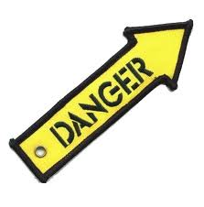
MARIJUANA HAS BECOME MUCH STRONGER OVER THE YEARS
Addiction
School Failure and Suspensions
Emergency Room Visits
Poison Control Calls
National Marijuana Initiative
Notes:
https://www.thenmi.org/
Teacher Comments:
THC, the addictive chemical in marijuana, has increased significantly overtime.
Marijuana is now 3 to 7.5 times more potent (stronger) than it was 20 years ago.
Addiction is a strong urge to keep taking a drug even when it is causing harm (problems in relationships, with academics, legal issues, emotional problems, etc.).
Further explanation of addiction is provided later in this power point.
https://www.mjfactcheck.org/potency
Teacher Notes:
Marijuana concentrates, another form of marijuana, contain extremely high levels of THC (40%-90%) and are used in various forms - food, drink, smoked, and vaped, increasing the potential for addiction. Increases in marijuana potency may be the cause for a rise in emergency room visits.

Slide 8
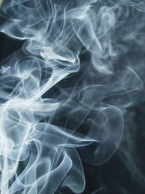
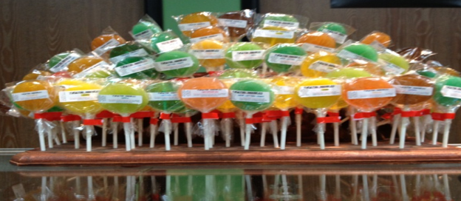
How is Marijuana Used?
Smoked
Vaped
Eaten
Notes:
Marijuana: Facts for Teens, 2017, National Institute on Drug Abuse (NIDA)
https://d14rmgtrwzf5a.cloudfront.net/sites/default/files/marijuana_teens.pdf

Slide 9

What Happens When Someone Uses Marijuana?
Possible Short Term Effects
Marijuana use can interfere with:
Thinking
Coordination and balance
Memory
Delusions/Hallucinations/Panic
Decision making
Concentration & Learning
Motivation
School and athletic performance
NIDA
Notes:
Teacher Comments:
No one can control the effects marijuana will have on him/her. Effects for the same person may also be different over time.
Some effects such as concentration/learning problems, motivation problems, and paranoia/panic can last for days after marijuana is used.
Use of high potency marijuana/THC products can produce strong fears and loss of touch with reality (delusions/hallucinations/panic). This can be frightening and dangerous.
Every time a drug is used, there is a risk.
Marijuana Drug Facts, December 2019, National Institute on Drug Abuse (NIDA)
http://www.drugabuse.gov/publications/drugfacts/marijuana
Marijuana: Facts for Teens, 2017, National Institute on Drug Abuse (NIDA)
https://d14rmgtrwzf5a.cloudfront.net/sites/default/files/marijuana_teens.pdf
Teacher Notes:
Users are not likely to experience ALL of these effects EVERY time marijuana is used.

Slide 10
What Happens When Someone Uses Marijuana?
Possible Long Term Effects
Risk of Addiction
School failure and drop out
Permanent brain changes
Depression, suicidal thoughts
Eating and sleeping problems
Breathing problems
NIDA
Notes:
Teacher Comments:
There can be many negative long term effects when someone uses marijuana.
Marijuana use in teenage years may hinder brain development, study finds - UPI.com
Marijuana Drug Facts, December 2019, National Institute on Drug Abuse (NIDA)
http://www.drugabuse.gov/publications/drugfacts/marijuana

Slide 11
Is Vaping Marijuana Safe? NO!
When marijuana is vaped, dangerous chemicals are inhaled.
Research shows that vaped marijuana can contain toxic chemicals and metal particles from the vaping device itself.
Scientists continue to study the risks of vaping.
NIDA
Notes:
Marijuana: Facts for Teens, 2017, National Institute on Drug Abuse (NIDA)
https://d14rmgtrwzf5a.cloudfront.net/sites/default/files/marijuana_teens.pdf

Slide 12
Is Eating Marijuana Safe? NO!
Marijuana is sometimes mixed into food (brownies, cookies, and candy, etc.) or into drinks (soda and tea, etc.).
The potency (strength) of edible marijuana (marijuana eaten) is often very high.
The negative effects of edible marijuana can be strong and unpredictable.
Some people that have used edible marijuana have had to be treated in hospital emergency rooms.
NIDA
Notes:
Teacher Notes:
A Rise in Marijuana’s THC Levels
The amount of THC in marijuana has been increasing steadily over the past few decades.
When people begin to use marijuana they have a greater chance of harmful reactions to high THC levels.
The popularity of edibles increases the chance of harmful reactions.
Edibles take longer to digest and produce a high.
Therefore, people may consume more to feel the effects faster, leading to dangerous results.
Higher THC levels can result in a greater risk for addiction
Marijuana Drug Facts, December 2019, National Institute on Drug Abuse (NIDA)
http://www.drugabuse.gov/publications/drugfacts/marijuana

Slide 13

Marijuana is Addictive
The YOUNGER marijuana use begins, the GREATER the risk of addiction.
1 in 6 teens that use marijuana become addicted. NIDA
Notes:
Teacher Notes:
It is estimated that 9% (about 1 in 11) of adults who use marijuana will become dependent on it.
The number goes up to about 1 in 6 in those who start using in their teens and to 25–50 percent (up to 5 out of 10) among daily users.
Marijuana: Facts for Teens, 2017, National Institute on Drug Abuse (NIDA)
https://d14rmgtrwzf5a.cloudfront.net/sites/default/files/marijuana_teens.pdf
Twelfth graders in states that have passed medical marijuana use at significantly higher rates than 12th graders in states without medical marijuana.
Monitoring the Future 2020 http://monitoringthefuture.org/

Slide 14

Addiction is…
when people have problems because of their drug use and can’t stop even if they want to stop.
NIDA
Notes:
Click on this slide to bring up definition
Marijuana Research Report July 2020
https://www.drugabuse.gov/publications/research-reports/marijuana/marijuana-addictive

Slide 15



Stopping Marijuana Use Can Be Very Hard
When someone tries to stop using marijuana, they often:
Are Irritable
Are Stressed & Nervous
Have urges to keep using
Have problems sleeping
NIDA
Notes:
Marijuana: Facts for Teens, 2017, National Institute on Drug Abuse (NIDA)
https://d14rmgtrwzf5a.cloudfront.net/sites/default/files/marijuana_teens.pdf

Slide 16

Video Why Are Drugs So Hard to Quit?
Notes:
Video: Click on the black box. Why Are Drugs So Hard to Quit (2:03 minutes)
https://www.youtube.com/watch?v=Xbk35VFpUPI&t=9s (link to video if needed)
This brief video provides information regarding addiction.
After showing the video, ask the following questions.
Discussion Questions:
What is the definition of addiction in the video?
Feeling a strong urge to keep taking a drug even when it is causing harm.
When someone becomes addicted to marijuana or other drugs, what problems can they have?
Answers can include poor grades, problems with friends and family, legal problems, difficulty playing sports, etc.

Slide 17

Why Do Some Teens Try Marijuana?
Pressure from friends
Boredom
To “experiment”
Influence of media
To “fit in”
To do something you are not supposed to do
Curiosity To deal with feelings
Believe it’s safe
NIDA
Notes:
STOP THIS SLIDE AFTER THE QUESTION “Why Do Some Teens Try Marijuana?”.
Group Activity:
Ask students the question more specifically, “Why do you think some teens try marijuana after they have been given information about how risky marijuana use is?”
(Remind them about the drug prevention/education programming they may have received in elementary/middle schools, e.g. DARE, SMART Moves, etc.)
Brainstorm and write their answers on the board.
Discuss their answers.
Resume showing the complete slide.
STOP at “Believe it’s safe” to prevent going to the next slide.
Discuss any reasons teens might try marijuana that haven’t already been mentioned.
Marijuana: Facts Parents Need to Know 2018, National Institute on Drug Abuse (NIDA)
https://d14rmgtrwzf5a.cloudfront.net/sites/default/files/mj_parents_facts_brochure.pdf

Slide 18
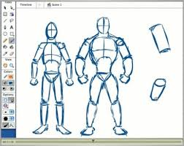
Marijuana & the Body
Using marijuana can damage your:
Heart
Lungs
Brain
NIDA
Notes:
Teacher Comments:
Marijuana use can, over time, damage parts of the body.

Slide 19
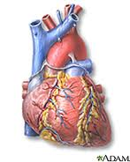
Marijuana & the Heart
A healthy heart normally has 70 to 80 beats per minute.
Marijuana use can make the heart race up to 160 beats per minute.
This can negatively affect the heart.
NIDA
Notes:
Teacher Notes:
Heart attack risk may be related to increased heart rate, as well as the effects of marijuana on heart rhythms, causing quick and irregular heart beats.
This can be a frightening experience for the person using marijuana.
Marijuana Drug Facts, December 2019, National Institute on Drug Abuse (NIDA)
http://www.drugabuse.gov/publications/drugfacts/marijuana

Slide 20
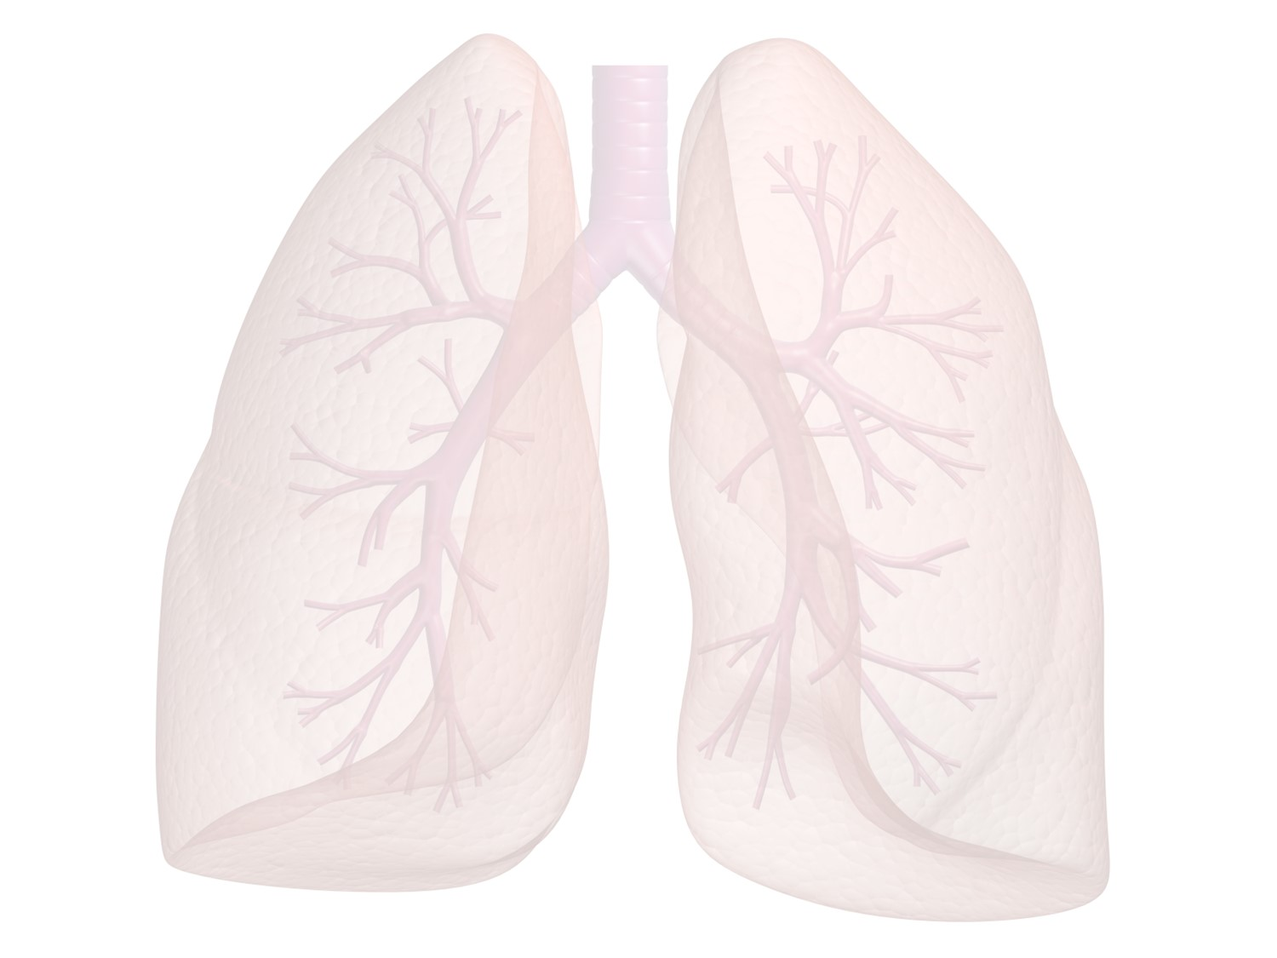
Marijuana & the Lungs
Like tobacco smoke, marijuana smoke irritates the throat and lungs.
Marijuana smoke can create breathing and lung problems (cough, phlegm, chest illnesses, greater risk of lung infection) over time.
NIDA
Notes:
Teacher Notes:
Marijuana smoke irritates the lungs, and frequent marijuana smokers can have many of the same respiratory problems experienced by tobacco smokers.
These problems include daily cough and phlegm production, more frequent acute chest illness, and a heightened risk of lung infections.
Marijuana: Research Report Series, July 2020, National Institute on Drug Abuse (NIDA)
https://www.drugabuse.gov/download/1380/marijuana-research-report.pdf?v=d9e67cbd412ae5f340206c1a0d9c2bfd

Slide 21
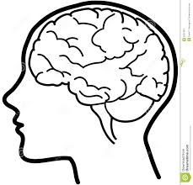
Marijuana & the Brain
Your brain is not fully developed until you are about 25 years old or older.
Marijuana use can damage your developing brain and seriously effect your ability to think, learn, and make healthy decisions. NIDA
Notes:
Marijuana: Facts Parents Need to Know, 2018, National Institute on Drug Abuse (NIDA)
https://d14rmgtrwzf5a.cloudfront.net/sites/default/files/mj_parents_facts_brochure.pdf
Marijuana: Research Report Series, July 2020, National Institute on Drug Abuse (NIDA)
https://www.drugabuse.gov/download/1380/marijuana-research-report.pdf?v=d9e67cbd412ae5f340206c1a0d9c2bfd

Slide 22
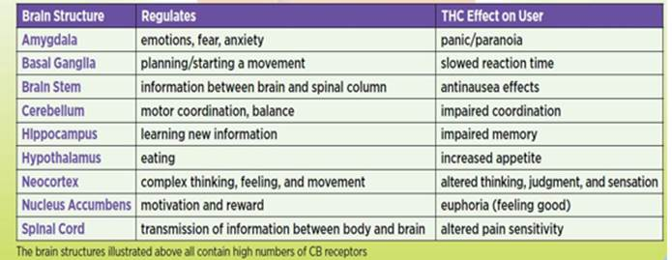
Marijuana & the Brain
Brain Structure…Controls…………….......Teen marijuana use can cause
SCHOLASTIC, NIDA, NIH, U.S. DEPARTMENT OF HHS
Notes:
Teacher Comments:
Marijuana use negatively effects many areas of the developing teen brain.
Teacher Note:
This diagram is taken from NIDA, National Institute of Health, U.S. Dept. of Health and Human Services and included in Scholastic Magazine, Heads Up Real News About Drugs and Your Body. http://headsup.scholastic.com/students/the-science-of-marijuana

Slide 23
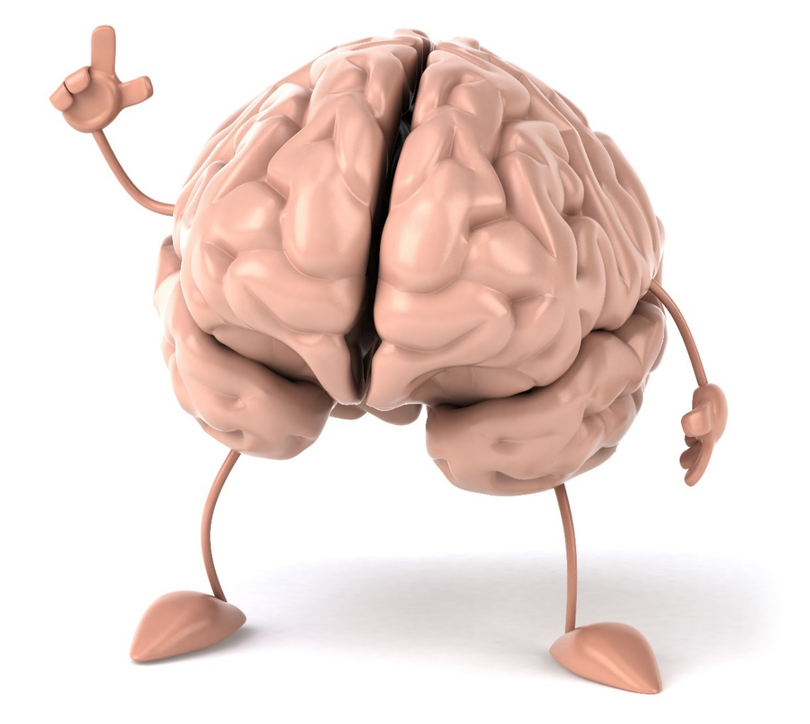
Marijuana & the Brain
Marijuana use negatively effects
parts of the brain
that control:
Memory
Judgment and Decision Making
Movement/ Coordination
Emotions
and more……
NIDA
Notes:
Teacher Comments:
When a person smokes marijuana, THC, the addictive part of marijuana, quickly passes from the lungs into the bloodstream.
The blood carries THC to the brain and other organs throughout the body.
THC effects many parts of the brain.
Group Activity (Pair & Share):
Have students pick a partner seated near them.
Tell students: “You have one minute to turn to your partner and choose one of the areas listed on the slide, (e.g. memory, judgment/decision making, etc.) Discuss examples of problems created by marijuana use on that area of the brain.”
After 60 seconds, ask students to share with the class some of the problems they discussed.
Allow sharing for about 2 – 3 minutes until all areas have been covered.
If students are struggling to provide examples with any area of brain function, use the following information:
Memory – Being able to learn and take tests at school, remembering plays or routines for a sport, etc.
Judgment/Decision Making – Not being honest with parents or friends, saying things that upset others, not doing your homework or studying, etc.
Movement/Coordination – Performing well in sports or playing a musical instrument well, etc.
Emotions – Feeling good about yourself, managing problems when they happen, handling disappointments, etc.
Marijuana Drug Facts, December 2019, National Institute on Drug Abuse (NIDA)
http://www.drugabuse.gov/publications/drugfacts/marijuana

Slide 24

Video Teen Brain Development
Notes:
Video: Click on the black box. Teen Brain Development (3:10 minutes)
https://www.youtube.com/watch?v=EpfnDijz2d8 (link to video if needed)
NIDA explores in this video the intriguing similarities between the processes of brain development and computer programming.
The analogy helps us understand why toxic environmental factors like drugs, bullying, or lack of sleep can have such a long-lasting
impact on a teenager’s life and can be used to empower your children or students with information they need make better decisions.

Slide 25

Marijuana & Emotions
Regular use of marijuana significantly increases a teen’s risk of depression and anxiety.
Marijuana use can make depression, anxiety, and other emotional problems worse and has been linked to suicidal thoughts and psychosis.
Marijuana use can take away the desire to participate in activities and succeed in school.
NIDA
Notes:
Teacher Comments:
Psychosis means that someone cannot tell the difference between what is real and what is not.
It is a very serious mental health problem that can be brought on by marijuana use in some circumstances.
Teacher Notes:
In addition to psychosis, regular marijuana use has been linked to increased risk for several mental problems, including depression, anxiety, suicidal thoughts, and personality disturbances.
One of the potential effects is amotivational syndrome— a diminished or lost drive to engage in formerly rewarding activities.
Whether this syndrome is a disorder unto itself or is a subtype of depression associated with marijuana use remains controversial.
Furthermore, whether marijuana causes these problems or is a response to them is still unknown.
More research is needed to confirm and better understand these links.
Marijuana: Facts Parents Need to Know 2018, National Institute on Drug Abuse (NIDA)
https://d14rmgtrwzf5a.cloudfront.net/sites/default/files/mj_parents_facts_brochure.pdf

Slide 26

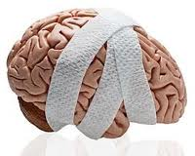
Marijuana & School
Marijuana’s negative effects on attention, memory, and learning can last for days and sometimes weeks—especially if marijuana
is used often.
NIDA
NIDA
Notes:
Teacher Notes:
Someone who smokes marijuana daily may be functioning at a reduced intellectual level most or all of the time.
Marijuana: Facts Parents Need to Know 2018, National Institute on Drug Abuse (NIDA)
https://d14rmgtrwzf5a.cloudfront.net/sites/default/files/mj_parents_facts_brochure.pdf

Slide 27

Marijuana & School
Marijuana Users:
Have a harder time learning
Are more likely to get lower grades
Are more likely to drop out of school than non-users
NIDA
Notes:
Teacher Notes:
Marijuana is linked to lower grades, school failure, and poorer quality of life.
Marijuana has negative effects on attention, motivation, memory, and learning that can persist after the drug's immediate effects wear off—
especially in people who use regularly.
Someone who uses marijuana daily may be functioning at a reduced intellectual level most or all of the time.
Compared with their nonsmoking peers, students who use marijuana tend to get lower grades and are more likely to drop out of high school.
People who use marijuana regularly for a long time report decreased overall life satisfaction, including poorer mental and physical health,
memory and relationship problems, lower salaries, and less career success.
Marijuana: Facts Parents Need to Know 2018, National Institute on Drug Abuse (NIDA)
https://d14rmgtrwzf5a.cloudfront.net/sites/default/files/mj_parents_facts_brochure.pdf

Slide 28


Marijuana & Sports
Marijuana use affects timing, movement, coordination, and concentration, and can interfere with athletic performance. NIDA
Notes:
Teacher Comments:
Marijuana use:
Decreases eye-hand coordination
Slows reaction time
Reduces motor coordination
Slows reflexes
Impairs tracking ability and perceptual accuracy
Impairs concentration, and time appears to move more slowly
Causes short and long-term memory loss, "I can't remember the plays, coach"
Difficulty in thinking and problem solving, "They changed their defensive formation, I can't figure out what to do"
Decreases motivation to perform and/or give maximum effort
Marijuana: Facts for Teens, 2017, National Institute on Drug Abuse (NIDA)
https://d14rmgtrwzf5a.cloudfront.net/sites/default/files/marijuana_teens.pdf

Slide 29

Video Pot Surgeon
Notes:
Video: Click on the black box.
Pot Surgeon (30 seconds)
https://www.youtube.com/watch?v=TAx1_CsJc1k (link to video if needed)
This humorous video shows the effects of marijuana on a doctor about to perform surgery.
After showing the video, ask the following question.
Discussion Question:
This video shows the effects of marijuana use on a doctor. What other professionals provide services that would be negatively effected by marijuana use?
(Answers could include bus driver, pilots, teacher, factory workers, cab drivers, dentists, etc.)

Slide 30
MOST teens
DO NOT use Marijuana.
Notes:
Teacher Notes:
Students typically believe that “everyone” uses marijuana, even though research does not support that perception.
Group Activity (preparing students for next slide):
Ask students – “If you have 10 high school students, estimate how many of them DO NOT use marijuana?”
Write the estimates on the board.
Go to the next slide

Slide 31
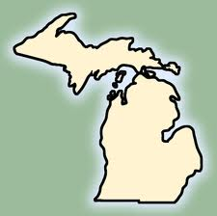
U.S. Teens (2020)
MTF 2020
30 days Before the Survey | 8th Graders | 10th Graders | 12th Graders
Did NOT Use Marijuana | 93% 9 out of 10 | 83% 8 out of 10 | 79% 8 out of 10
Notes:
Teacher Comments:
The Monitoring the Future Survey (MTF) is a series of questions given to teens across the country, including those in Michigan.
Some of the questions ask about use of marijuana. You can see that most teens that took the survey said that they DO NOT use
marijuana in the 30 days prior to the survey.
Teacher Notes:
Tenth and twelfth grade students in the United States who took the Monitoring the Future Survey in 2020 reported past 30 day
marijuana use of 16.6% for 10th grade and 21.1% for 12th grade.
Monitoring the Future (MTF) is a nationwide surveying effort led by The University of Michigan, to monitor students' health
risks and behaviors in six categories identified as most likely to result in adverse outcomes.
These categories include unintentional injury and violence, tobacco use, alcohol and other drug use, sexual behaviors that
contribute to unintended pregnancy or disease, dietary behaviors, and physical inactivity.
High response rates allow results of the Monitoring the Future to be generalized to all students in grades 9-12.
To get national results, visit the MTF website at www.monitoringthefuture.org.
The Michigan Profile for Healthy Youth (MiPHY) Survey provides county marijuana and other drug use data for teens at
www.michigan.gov/miphy.

Slide 32
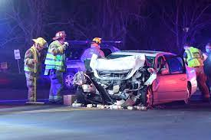
Marijuana & Driving
Marijuana use negatively affects skills needed to drive safely - alertness, concentration, coordination, and reaction time.
Marijuana use before driving has resulted in serious auto accidents across Michigan.
After using marijuana, it is hard to judge distances and react to signals and sounds on the road.
It’s NOT safe to drive after using marijuana.
It is NOT safe to ride with someone who’s been using marijuana in any form. NIDA
Notes:
Teacher Comments:
The risk of being in a car crash roughly DOUBLES after using marijuana.
Marijuana Drug Facts December 2019
https://www.drugabuse.gov/publications/drugfacts/drugged-driving#references
Teacher Notes:
In general, teen drivers are less experienced and more likely to react poorly in risky situations than older drivers.
They are more likely to drive recklessly, speeding and allowing less distance between vehicles.
When you pair that inexperience with marijuana use, the results can be dangerous.
Research shows that marijuana affects safe driving skills, like judgment, coordination, and reaction time.
Marijuana makes it hard to judge distances and react to signals and sounds on the road.
As with any psychoactive drug, impaired driving can cause deadly vehicle crashes.
Marijuana: Facts for Teens, 2017, National Institute on Drug Abuse (NIDA)
https://d14rmgtrwzf5a.cloudfront.net/sites/default/files/marijuana_teens.pdf

Slide 33
REMEMBER…..
Someone who uses drugs, including marijuana, risks hurting themselves physically and emotionally.
Marijuana use can have significant negative effects on the developing brain, family relationships, friendships, and the ability to perform well in school and sports.
It’s important to find ways to manage feelings, deal with stress, and have fun without using marijuana, alcohol, and other drugs.
Notes:
Teacher Notes:
This slide presents a summary of key issues related to teen marijuana use.

Slide 34
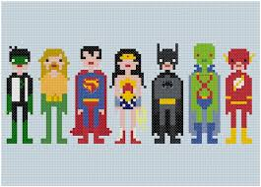
MOST teens
DO NOT use Marijuana.

Slide 35
Get The Facts…..
For more research based information:
www.drugabuse.gov
www.thecoolspot.gov
www.teens.drugabuse.gov
www.nimh.nih.gov
www.niaaa.nih.gov
Notes:
Teacher Notes:
Encourage students to go to one or more of these websites to check out the cool games, fact sheets, blogs, and interactive quizzes for teens.

